Slide 1
Twisted Scriptures
From Noah to Jim Crow,
How the Bible has been used to support racism
By Ann Fleming for CCPC October 2020

Slide 2
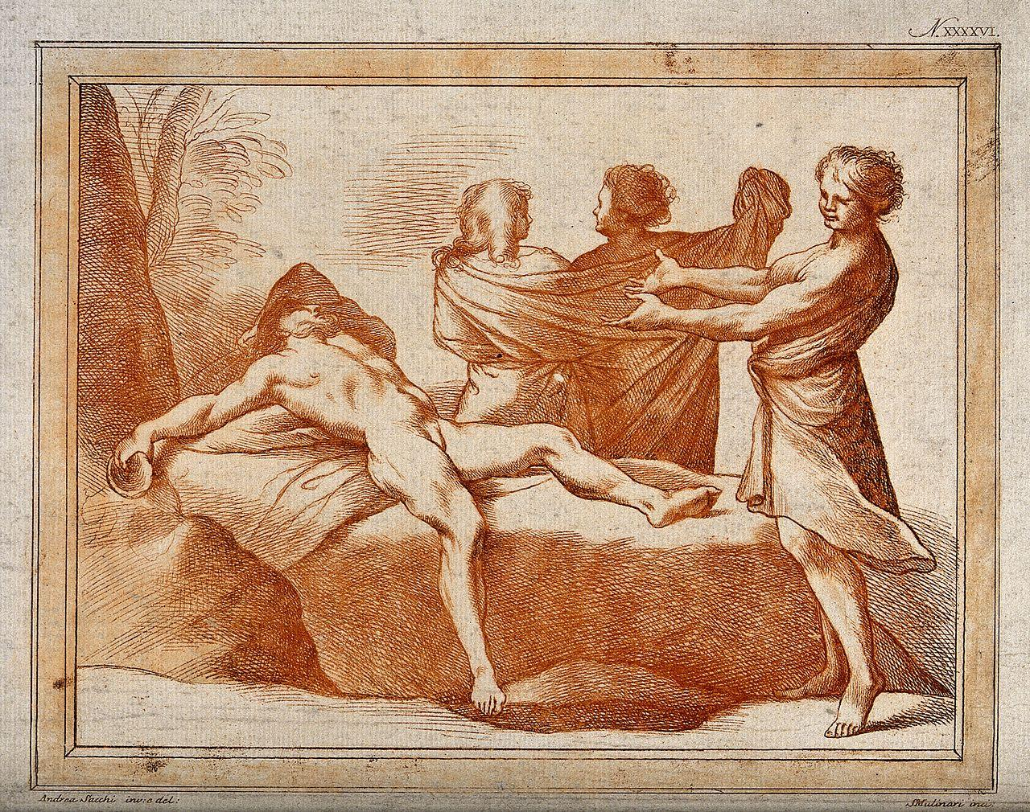
Drunk Noah & the curse of Canaan (@2500 BCE)
Noah’s grandson Ham’s son
Genesis 9: 18-27
24 When Noah awoke from his wine and found out what his youngest son had done to him, 25 he said,
“Cursed be Canaan!
The lowest of slaves
will he be to his brothers.”
26 He also said,
“Praise be to the Lord, the God of Shem!
May Canaan be the slave of Shem.
27 May God extend Japheth’s territory;
may Japheth live in the tents of Shem,
and may Canaan be the slave of Japheth.”
No mention of skin color here, but black skin came to be understood as part of this curse.
Notes:
Is it just me, or does this seem like a harsh reaction to laughing at your drunk grandfather? Maybe worse was done than laughing...

Slide 3
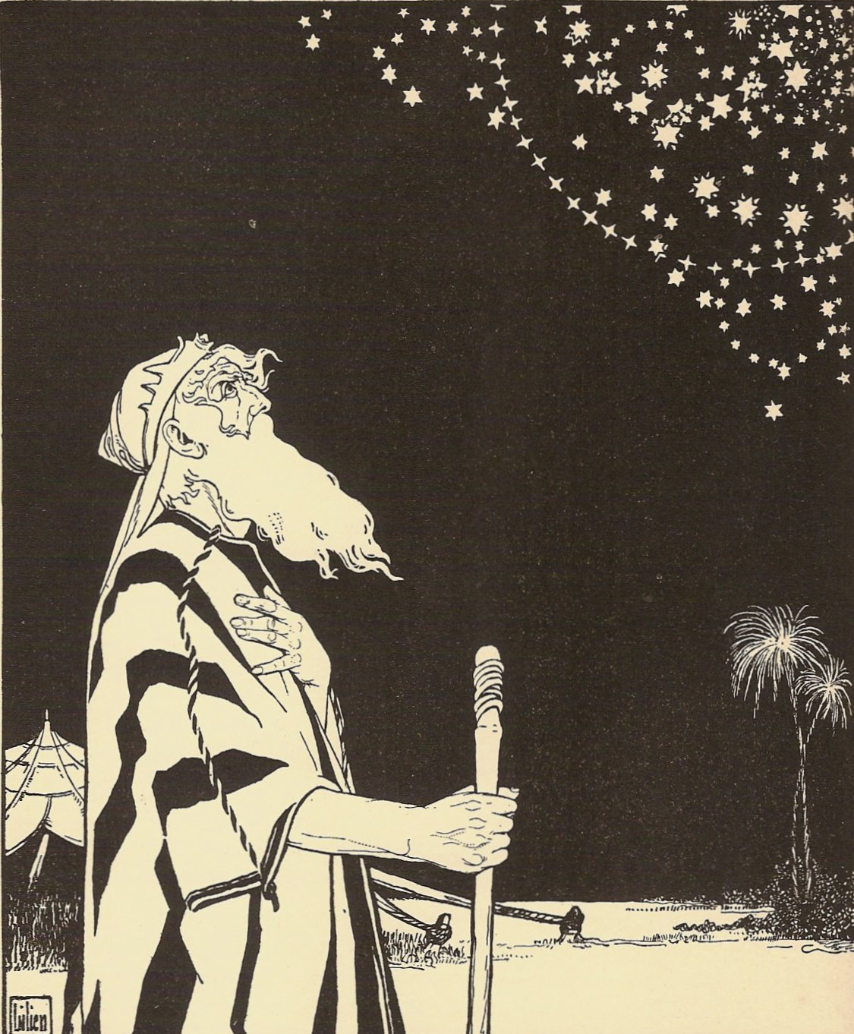
Abraham’s Descendants (early 2nd millennium BCE)
Genesis 15 - God’s PS on I will make of you a great nation
12 As the sun was setting, Abram fell into a deep sleep, and a thick and dreadful darkness came over him. 13 Then the Lord said to him, “Know for certain that for four hundred years your descendants will be strangers in a country not their own and that they will be enslaved and mistreated there. 14 But I will punish the nation they serve as slaves, and afterward they will come out with great possessions.

Slide 4
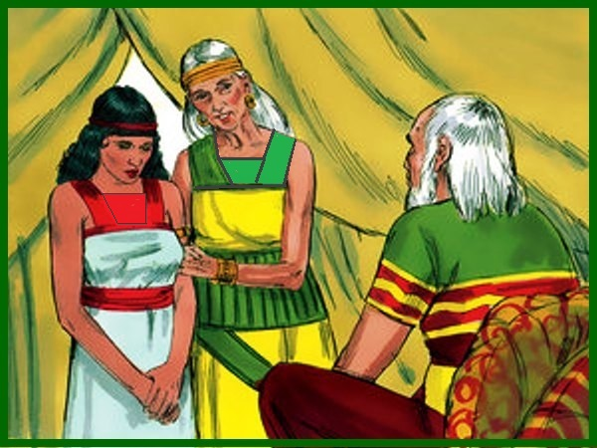
Sarai’s Slave
Genesis 16 - Sarai gives her Egyptian slave Hagar to Abraham to make a son
(Ironic that they are slaves to Egypt several generations later?)
Genesis 21 - Hagar and her son are left to die when no longer needed.
Basis for Margaret Atwood’s dystopian novel, The Handmaid’s Tale
Female slaves have always been the lowest of the low, creating ripple effects into modern generations

Slide 5
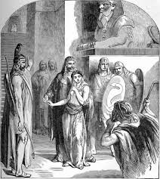
Abraham’s Slaves
King Abimelek of Gerar makes restitution for inadvertently marrying Abraham’s wife with gifts of slaves and cattle.
Genesis 20: 17-18 Then Abraham prayed to God, and God healed Abimelek, his wife and his female slaves so they could have children again, for the Lord had kept all the women in Abimelek’s household from conceiving because of Abraham’s wife Sarah.

Slide 6
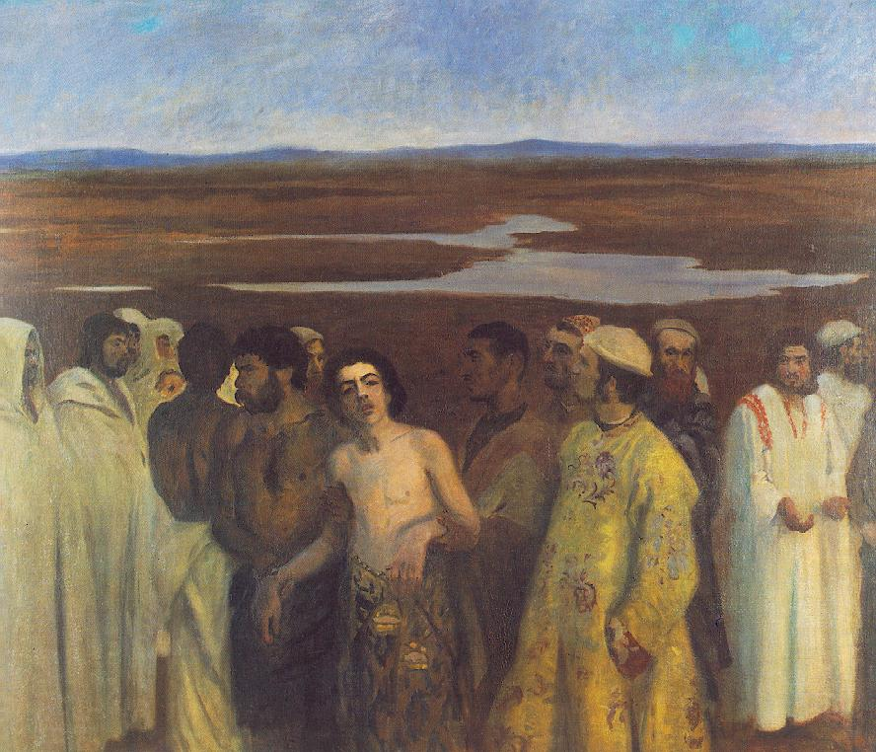
Joseph sold into slavery
Genesis 37 -
28 So when the Midianite merchants came by, his brothers pulled Joseph up out of the cistern and sold him for twenty shekels[a] of silver to the Ishmaelites, who took him to Egypt.
Karma for Ishmael?

Slide 7
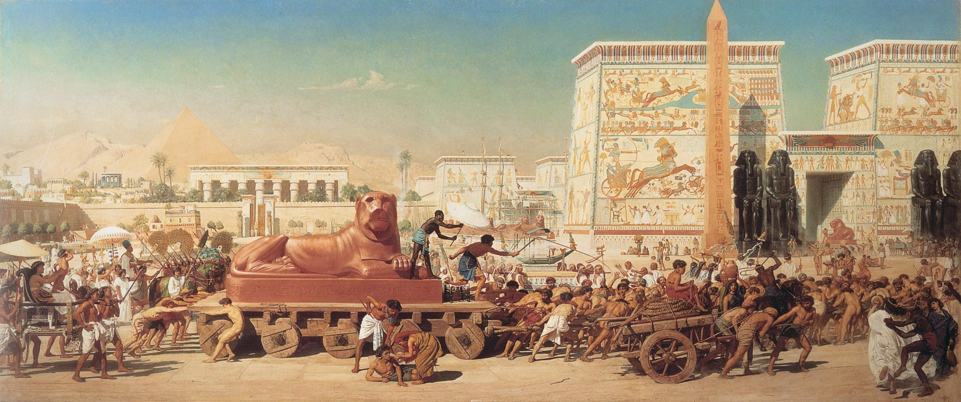
Israel’s enslavement and Exodus to the Promised Land
Passover, the basis of our communion ritual, is our celebration of being liberated from bondage, being selected for life!
Does a history of slavery make a people more compassionate?
Were the Israelites pre-ordained by God to be slaves? Were the Africans who were enslaved in America?

Slide 8
Laws of Moses and spoils of war
Exodus 21 contain many rules about the proper conduct of slave masters, and compensations for various injuries to slaves.
Exodus 23 makes the rest of the Sabbath for the slave as well.
Leviticus 25: 23 Do not rule over them ruthlessly, but fear your God.44 “‘Your male and female slaves are to come from the nations around you; from them you may buy slaves. 45 You may also buy some of the temporary residents living among you and members of their clans born in your country, and they will become your property.
Deuteronomy 23:15 If a slave has taken refuge with you, do not hand them over to their master.
Time of Judges & Kings, the defeated people become slaves to the victors. At this time, slavery was not based on skin color.

Slide 9
Aristotle’s Climate Theory (384-322 BCE)
Extreme hot & cold climates produced inferior people. No injustice in enslaving these people unable to govern themselves
Although he also meant Asia Minor - the Persians and Slavs, here is the beginning of slavery being based on skin color
“ Humanity if divided into two: the masters and the slaves; or, if one prefers it,the Greeks and the Barbarians, those who have the right to command, and those who are born to obey.” - Aristotle
America’s earliest colleges, today’s Ivy league, studied Aristotle’s writings while being served by slaves, including our founding fathers.
Notes:
Ethiopian is Greek for “burnt face”

Slide 10
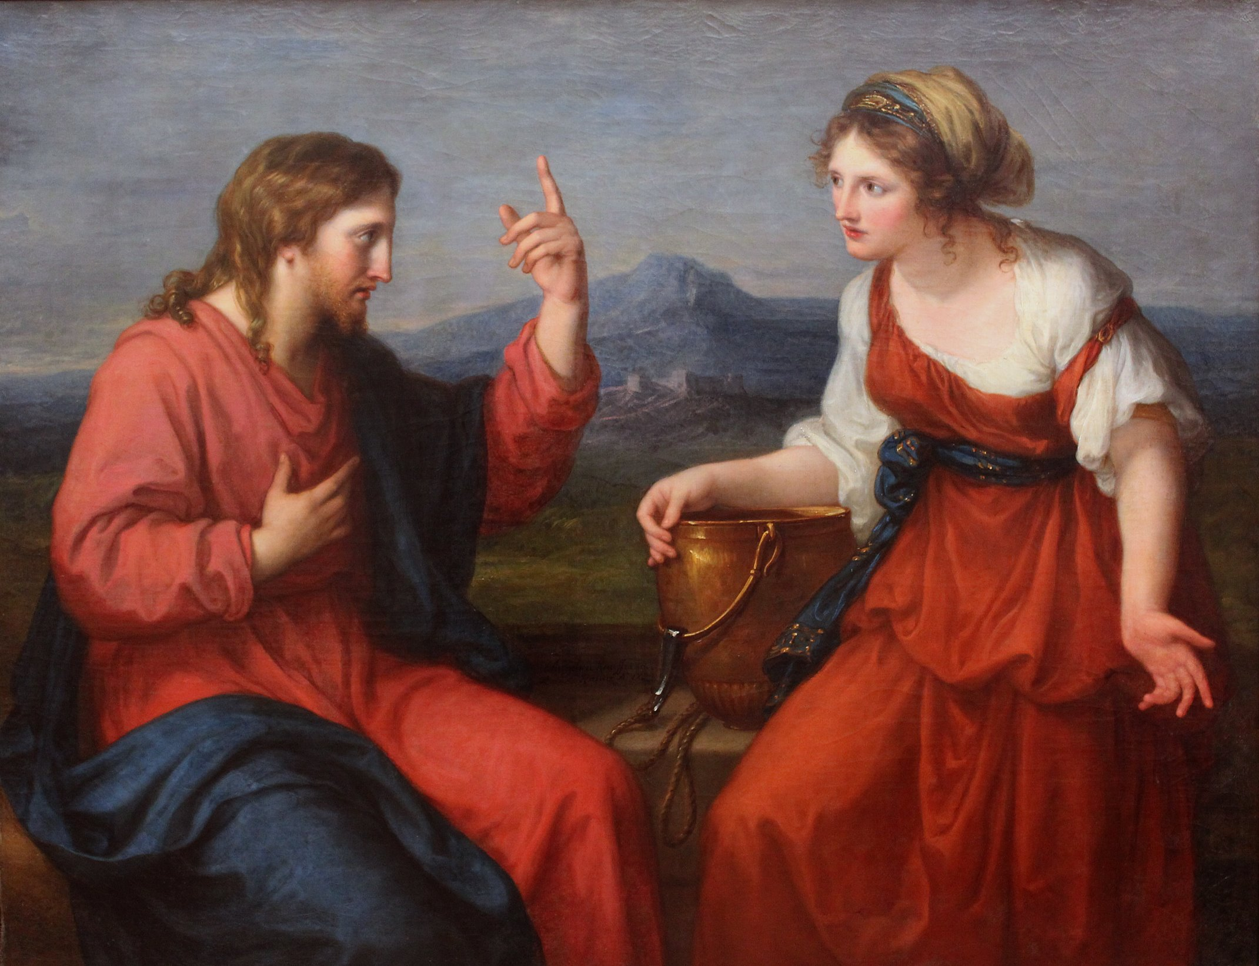
Jesus & the Outcast
Samaritans
Women
Prostitutes
Lepers
Tax Collectors
Gentiles
(See how white these portrayals are?)

Slide 11
Paul’s writings supporting liberty
I Corinthians 7: 21 Were you a slave when you were called? Don’t let it trouble you—although if you can gain your freedom, do so. 22 For the one who was a slave when called to faith in the Lord is the Lord’s freed person; similarly, the one who was free when called is Christ’s slave. 23 You were bought at a price; do not become slaves of human beings. 24 Brothers and sisters, each person, as responsible to God, should remain in the situation they were in when God called them.
Galatians 3:28 There is neither Jew nor Gentile, neither slave nor free, nor is there male and female, for you are all one in Christ Jesus.
Galatians 4:27 So you are no longer a slave, but God’s child; and since you are his child, God has made you also an heir.
Colossians 3:11 Here there is no Gentile or Jew, circumcised or uncircumcised, barbarian, Scythian, slave or free, but Christ is all, and is in all.
Notes:
He seems to be addressing Aristotelian thought here as well

Slide 12
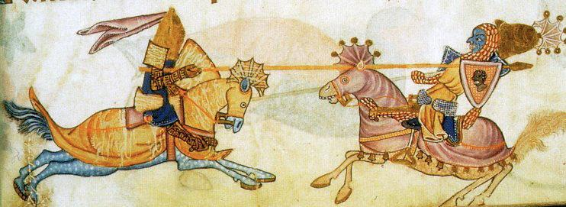
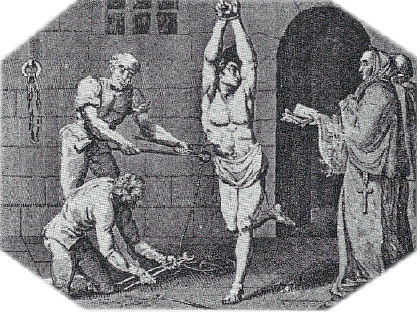
Ancient History
The Crusades
The “Spanish” Inquisition
Colonialism
The term slave comes from Slav
Is modern Islamophobia & anti-Semitism the cause or result of terrorism?
Prince Henry and the Portugese were the first to take ships down the African coast to cut out the Mulsim middlemen in the trans-Saharan trade.
1444 - first boat returns to Portugal with African slave
Notes:
You’d be surprised how many websites are defensive about these periods.
Targets were Jews, Muslims, and protestant heretics

Slide 13
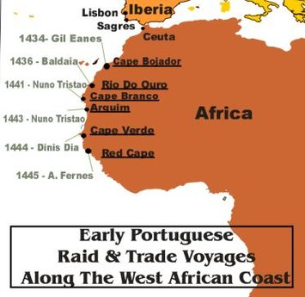
1400’s shift from Eastern Europeans to Africans
Prince Henry, working with Portugese convinced the pope and others who wanted slaves that the Africans were no better than beasts because…
They knew nothing of bread & wine
They lived like beasts without clothing or houses
As their slaves, these creatures would have a chance of salvation.
Debate about why grew. Was it just the climate? It they moved north, did Africans become less inferior? Or was it more permanent - the curse of Ham?
Notes:
Extra-biblical tale of Noah demanding celibacy of his sons on the ark, but Ham couldn’t wait.

Slide 14
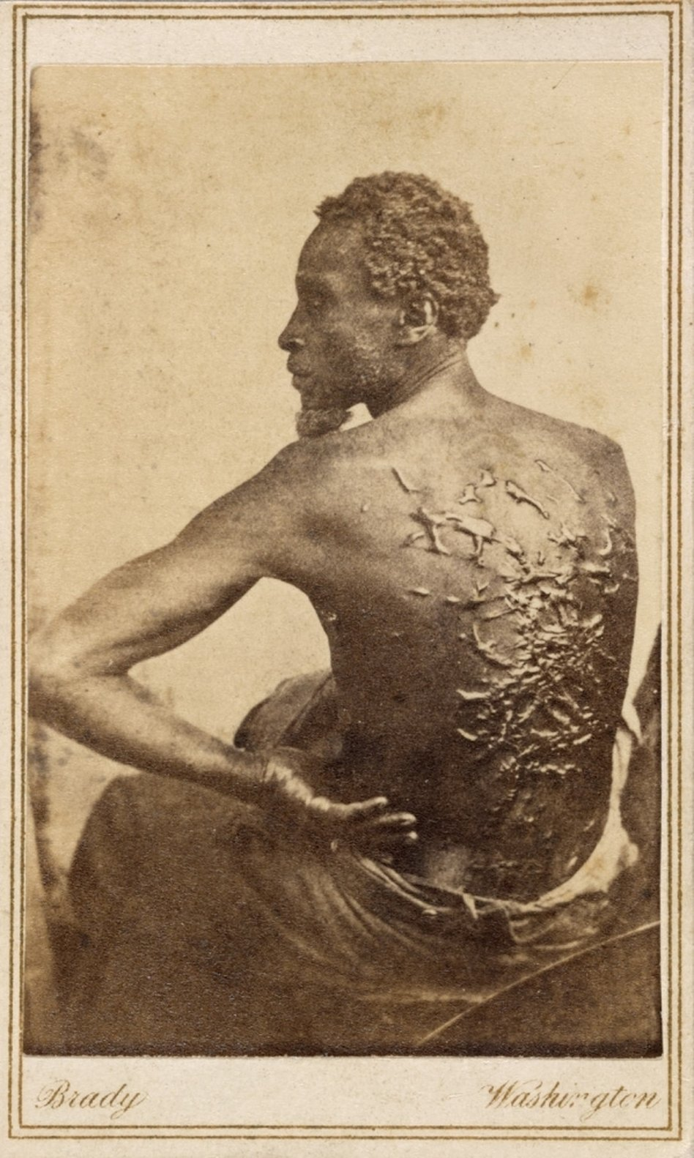
First Slaves in America - 1619
Record of 20 Africans sold at Jamestown off a pirate ship that stole slaves off a Spanish ship.
Christians believed it would be good for “Mohammedans” to come into contact with Christians in America - even as slaves for a chance of salvation
An obedient slave was a “good slave”
1 Peter 2: 18-21 - Slaves, in reverent fear of God submit yourselves to your masters, not only to those who are good and considerate, but also to those who are harsh. For it is commendable if someone bears up under the pain of unjust suffering because they are conscious of God. But how is it to your credit if you receive a beating for doing wrong and endure it? But if you suffer for doing good and you endure it, this is commendable before God. To this you were called, because Christ suffered for you, leaving you an example, that you should follow in his steps.
Notes:
Plug Sara’s podcast club
Capitalism thrived on slavery. Today, it’s the cheapest labor possible even if that means overseas sweatshops

Slide 15
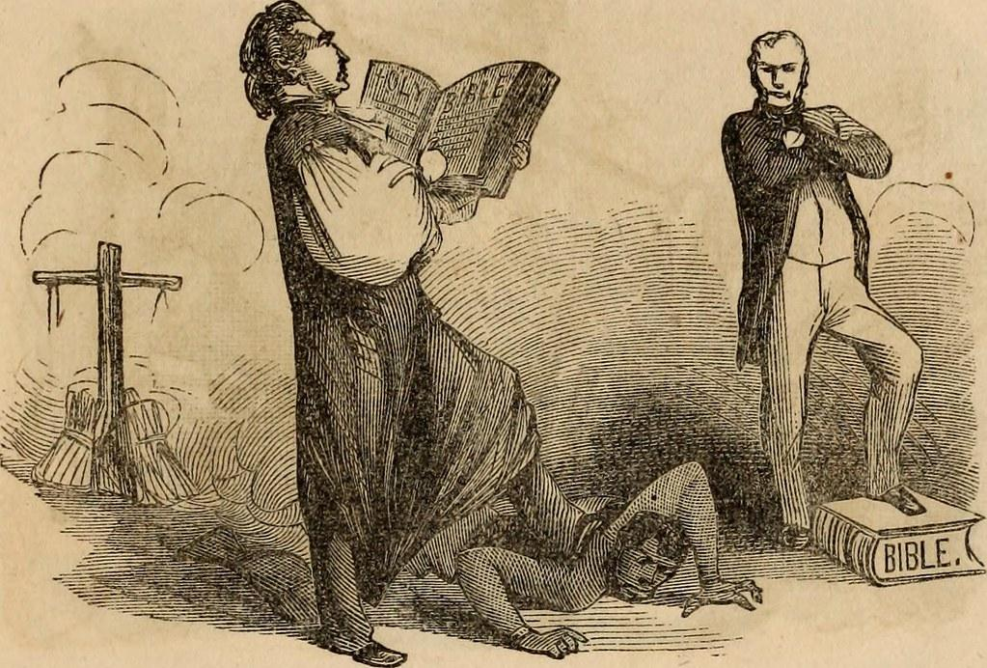
Paul’s words in pro-slavery sermons
Ephesians 6: 5-9 Slaves, obey your earthly masters with respect and fear, and with sincerity of heart, just as you would obey Christ. Obey them not only to win their favor when their eye is on you, but as slaves of Christ, doing the will of God from your heart. Serve wholeheartedly, as if you were serving the Lord, not people, because you know that the Lord will reward each one for whatever good they do, whether they are slave or free.
And masters, treat your slaves in the same way. Do not threaten them, since you know that he who is both their Master and yours is in heaven, and there is no favoritism with him.
God
Earthly Masters
Slaves
Notes:
Slave owners would display their wealth by having nice clothes for their slaves to wear to church. The sermons directed to them used these passages.

Slide 16
Slave Bible
From Christianity Today September 2020
The Bible endorsed our personhood, and through it, we endorsed one another in turn. The world outside rarely did. It was dangerous, therefore, this book—especially for a disempowered people. Consider the “Slave Bible,” displayed in the Museum of the Bible in Washington, DC. It was published by missionaries “for the use of the Negro slaves.” For fear of inciting rebellion, this “Bible” omits Scripture’s stories of heroics and freedom. Moses, for example, is barely mentioned. “You’ll see a jump from Genesis 45, and they’ve cut out all the material to Exodus 19,” said Anthony Schmidt, associate curator of Bible and religion in America at the museum. In fact, “about 90 percent of the Old Testament is missing [and] 50 percent of the New Testament,” Schmidt told NPR. “Put in another way, there are 1,189 chapters in a standard protestant Bible. This Bible contains only 232.”
Notes:
https://www.christianitytoday.com/ct/2020/september-web-only/cling-scripture-black-americans-bible-engagement-raybon.html

Slide 17
Romans 13: 1-5
Used by Britain to oppose the American Revolution
Used to support Fugitive Slave Laws
Protestant theologian Otto Dibelius use to urge Germans to support Hitler.
Jeff Sessions recently quoted in support of separation of immigrant families at our southern border.
Let everyone be subject to the governing authorities, for there is no authority except that which God has established. The authorities that exist have been established by God. 2 Consequently, whoever rebels against the authority is rebelling against what God has instituted, and those who do so will bring judgment on themselves. 3 For rulers hold no terror for those who do right, but for those who do wrong. Do you want to be free from fear of the one in authority? Then do what is right and you will be commended. 4 For the one in authority is God’s servant for your good. But if you do wrong, be afraid, for rulers do not bear the sword for no reason. They are God’s servants, agents of wrath to bring punishment on the wrongdoer. 5 Therefore, it is necessary to submit to the authorities, not only because of possible punishment but also as a matter of conscience.

Slide 18
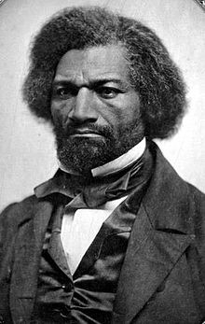
Rebelling against that authority
I appear this evening as a thief and a robber. I stole this head, these limbs, this body from my master, and ran off with them.
Frederick Douglas
When is it right to rebel against authority?

Slide 19
Questions for Breakout Groups
What is God’s role in slavery? Did God want Joseph to be sold to Egypt? Were the Israelites pre-ordained to be slaves? Were the Africans who were enslaved in America?
Are modern Islamophobia & anti-Semitism the cause or result of terrorism?
When is it right to rebel against authority?

Slide 20
We shall know them by their fruits...
Galatians 5
¹ It is for freedom that Christ has set us free. Stand firm, then, and do not let yourselves be burdened again by a yoke of slavery….
...¹³You, my brothers and sisters, were called to be free. But do not use your freedom to indulge the flesh; rather, serve one another humbly in love. For the entire law is fulfilled in keeping this one command: “Love your neighbor as yourself.” If you bite and devour each other, watch out or you will be destroyed by each other...
… ¹⁹ The acts of the flesh are obvious: sexual immorality, impurity and debauchery; idolatry and witchcraft; hatred, discord, jealousy, fits of rage, selfish ambition, dissensions, factions and envy; drunkenness, orgies, and the like. I warn you, as I did before, that those who live like this will not inherit the kingdom of God.
²² But the fruit of the Spirit is love, joy, peace, forbearance, kindness, goodness, faithfulness, gentleness and self-control. Against such things there is no law.
Notes:
Deleted verses expound on (arguments about circumcision)

Slide 21
Love & Light
1 John 2: 9-11
Anyone who claims to be in the light but hates a brother or sister is still in the darkness. Anyone who loves their brother and sister lives in the light, and there is nothing in them to make them stumble. But anyone who hates a brother or sister is in the darkness and walks around in the darkness. They do not know where they are going, because the darkness has blinded them.

Slide 22
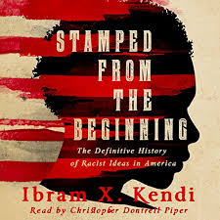
Resources:
https://www.bbc.co.uk/religion/religions/christianity/history/slavery_1.shtml
https://www.cnn.com/2018/06/22/opinions/jeff-sessions-bible-verse-nazi-germany-opinion-weber/index.html
https://roodscreen.org/why-we-as-christians-cannot-ignore-the-misuse-of-romans-13-ee7631d5b440
https://www.christianitytoday.com/ct/2020/september-web-only/cling-scripture-black-americans-bible-engagement-raybon.html

