Slide 1
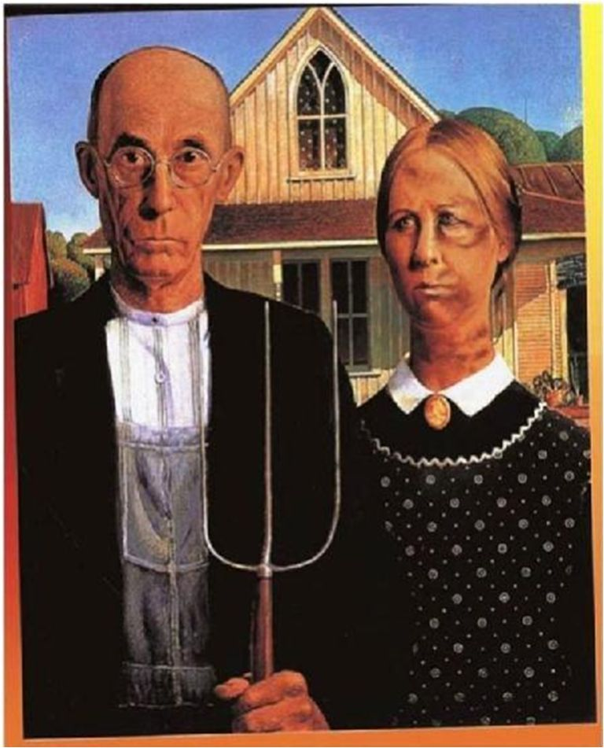
Ron Clark
Agape Church of Christ www.agapecoc.com

Slide 2
What is Misogyny?
This is Your Place

Slide 3
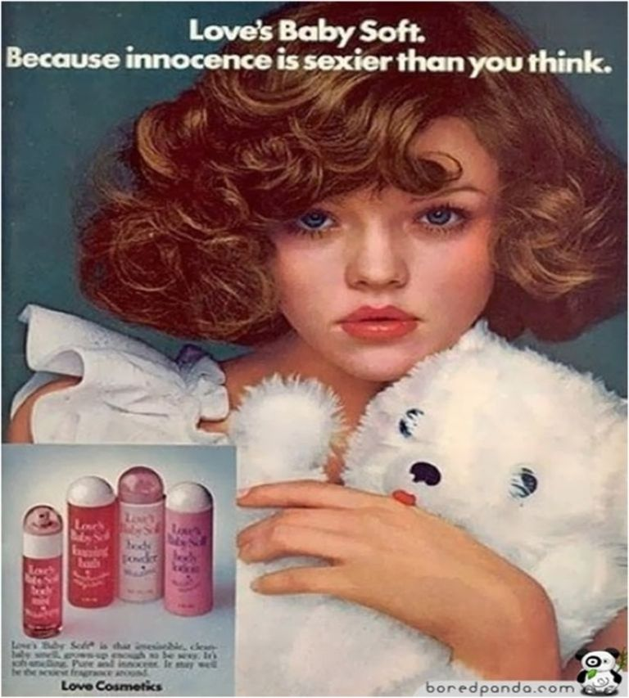

Slide 4
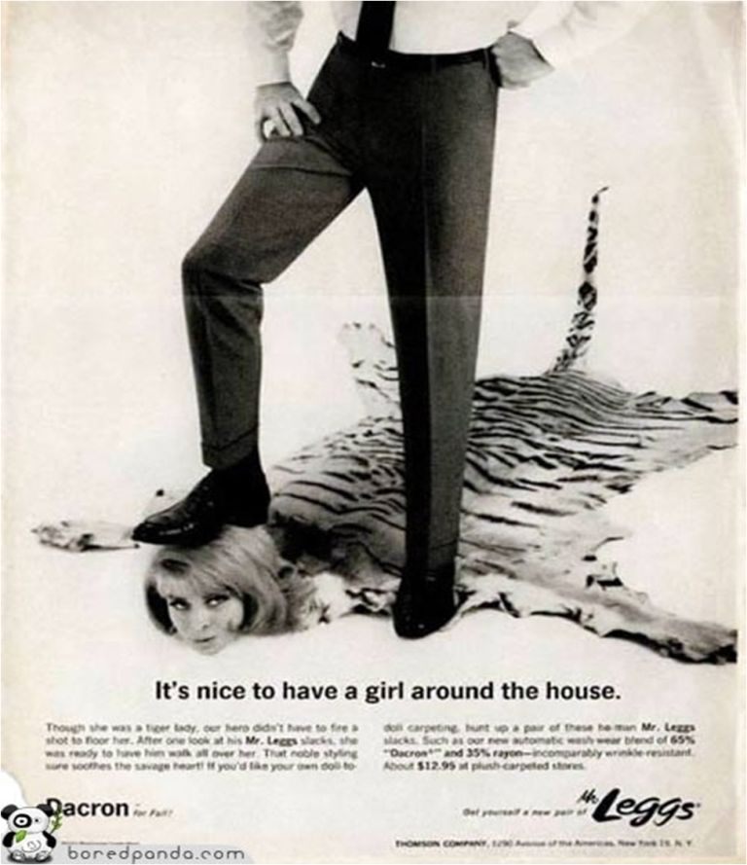

Slide 5
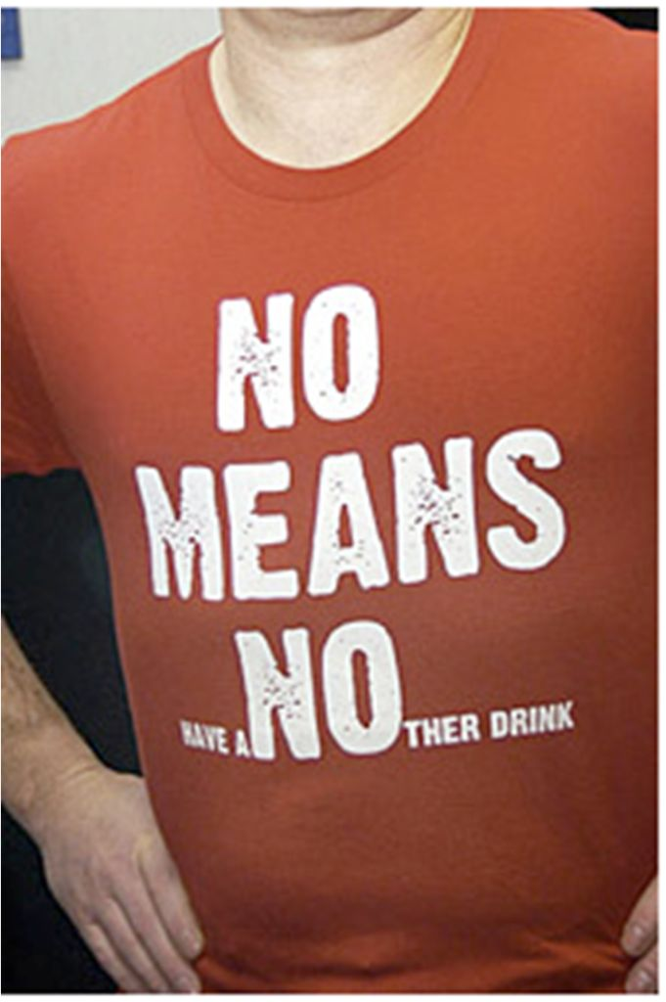
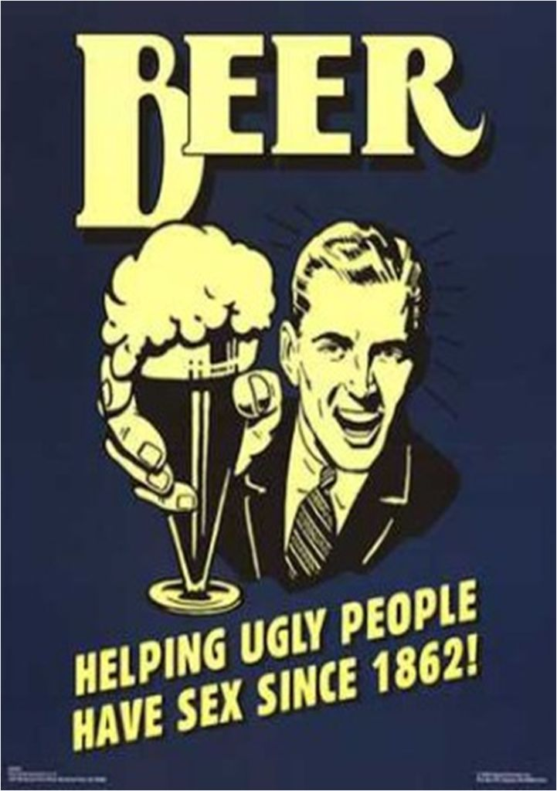

Slide 6
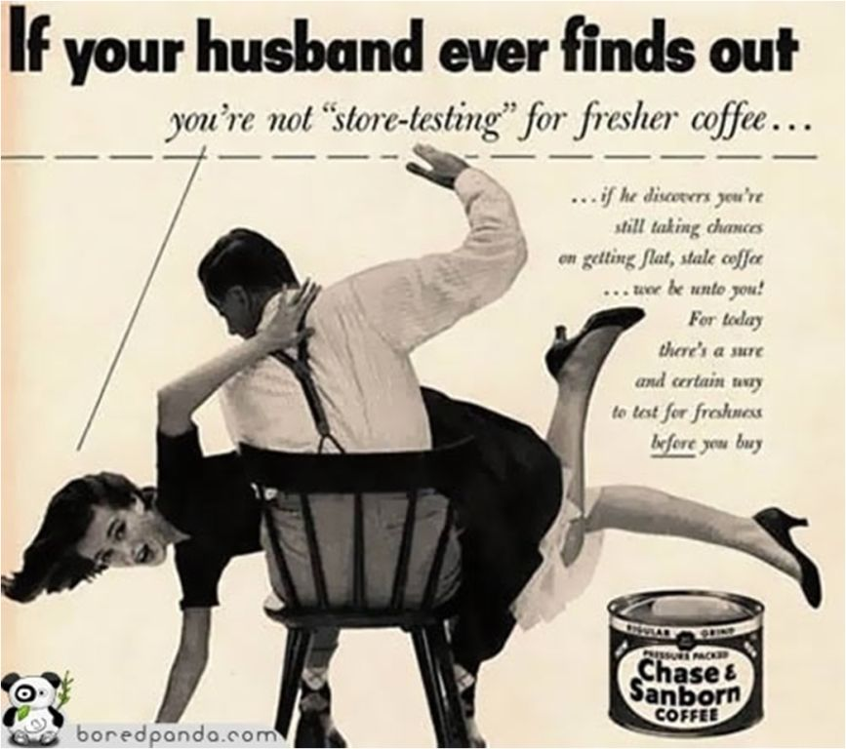

Slide 7
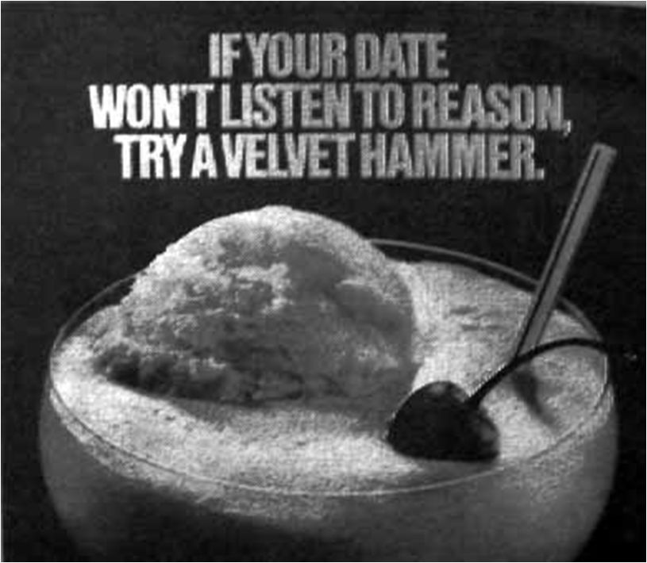
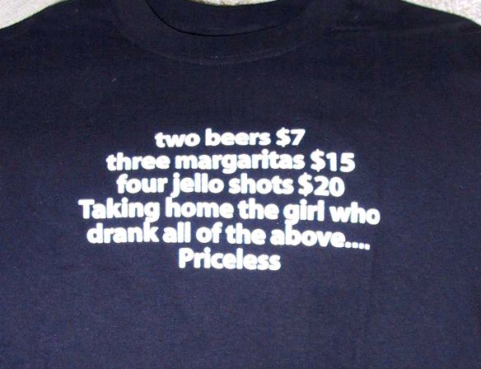

Slide 8
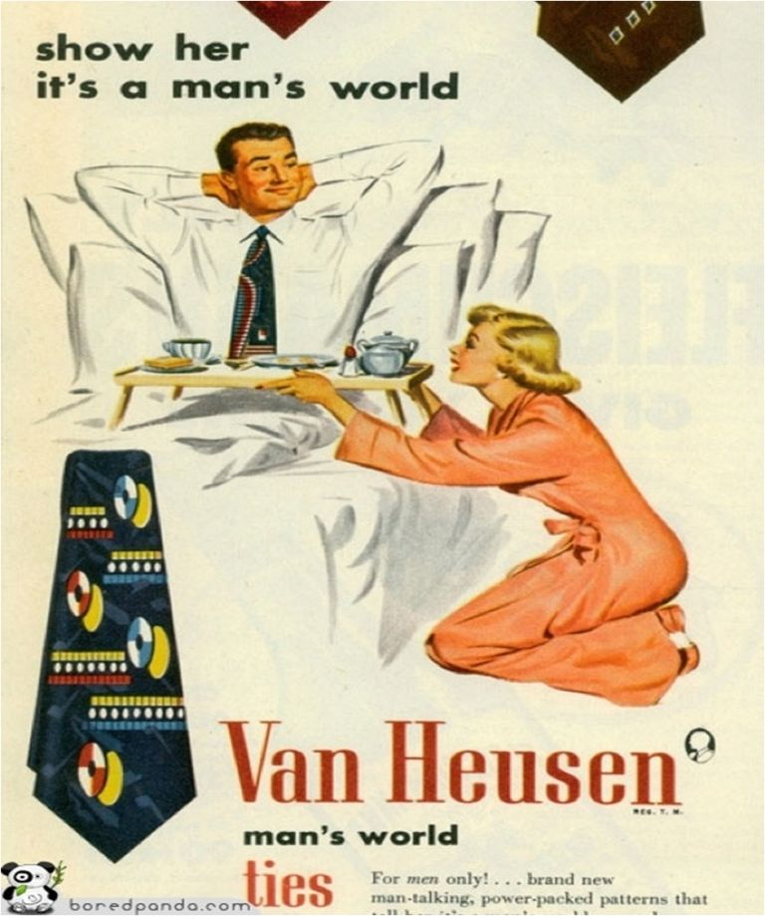

Slide 9
Address Misogyny:
Male and Female Behaviors
Girl
Sissy
strong
sexual
independent
tough
passionate
Woman
Wimp

Slide 10

Implications for Men/Humans
Sex and Violence key to male identity
Females become associated with powerless
Males who do not embrace violence and sex are part of the “outgroup”
Passive = feminine
Aggression = male

Slide 11
Damage to Males
Masculinity/Maleness as separation = rituals, etc
Men “ruined” when they associate/stay with female
Empathy and compassion negative behaviors
Men fear females and “female like behaviors”
Father wounds? Neglect or “not a stud”?
Males resist community

Slide 12
Women as the Enemy?
Females, weakness, and victims
  Victim blaming
  Men not responsible for actions
  Women, feelings, and emotions
  Manly behaviors vs womanly behaviors
Sex and Violence
  Rites of passage for boys/men
  Necessary to “civilize men/boys”

Slide 13
Abuse, Conflict, Power and Control
Terrorism = 90% males
Resistance = higher females
Conflict in arguments = equal

Slide 14
Fruits of Misogyny
Domestic, Sexual, and Dating Violence
Child Abuse
Pornography
Prostitution
Human/Sex Trafficking
Elder, Able Body, Racism, Classism, Sexism

Slide 15
Pornography and Misogyny
Purity Issue
Oppression/Compassion
Men being pure = women are the enemy
Self control and viewing women
Who is the temptation?
Resistance is the response to healing
Change our behaviors
Women are allies and co-image of God
Seeing women in the image of God
We are both in a battle between good and evil
Compassion & empathy response to healing
Change our view of women/humans

Slide 16
Prostitution As Oppression
Pimp
Respect
Consumer
Oppression
Victim

Slide 17
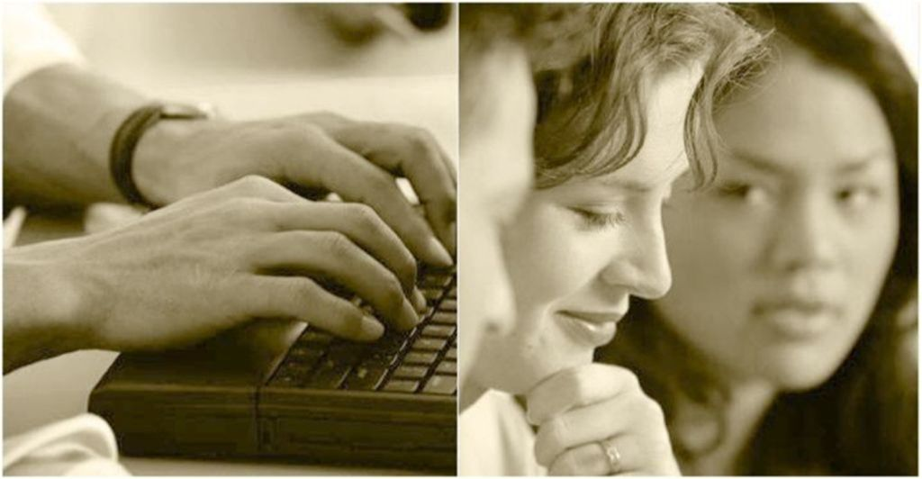
Women as Allies

Slide 18
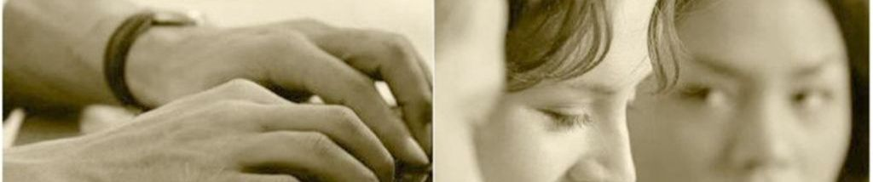
Addressing Misogyny is First Step
Misogyny is the root of these evils!
  Male’s ministries promote compassion and empathy (Yahweh is merciful)
  Faith communities empower females and vulnerable others to be safe and accepted = Jesus accepted females, children, oppressed
  Hold males accountable for behavior = repentance, prophets, those in power

Slide 19
Create a Climate of Acceptance and Empowerment
Confront oppression = prophets went to those in power, not the poor
Embrace the humiliated = Romans 12:16
Misogyny is a social evil = Luke 4:16-19
Power is to be shared = Ephesians 5:21
Spoken Word has power to heal = Ezekiel 37

Slide 20
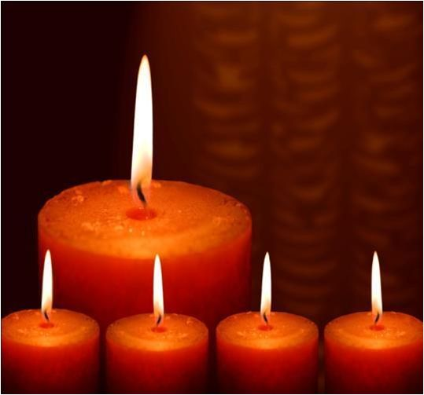
Themes from Faith Community
Luke 7: Jesus and the “Sinful Woman…”
1 Corinthians 5-7 and sex slaves
Why does the Bible talk about “whores” but not “pimps”?

Slide 21

Ron Clark
Agape Church of Christ www.agapecoc.com

