Slide 1
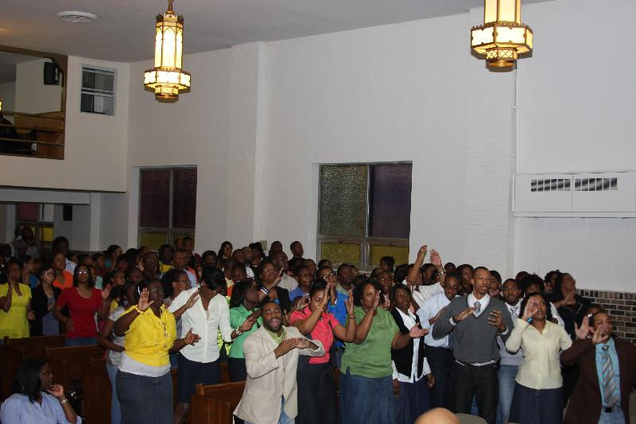
FIRST JURISDICTION ILLINOIS
YOUTH CHOIR 2011 HIGHLIGHTS
Elder Kenneth Lockhart Sis. Cathy Bogan
Minister of Music Choir President
Minister Cornelius Doles Sis. Tammy Reed
State Youth Choir Coordinators

Slide 2
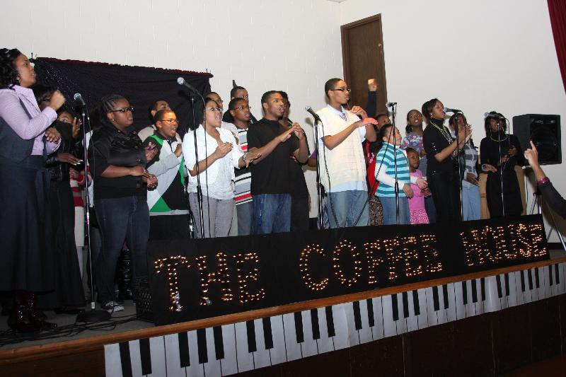
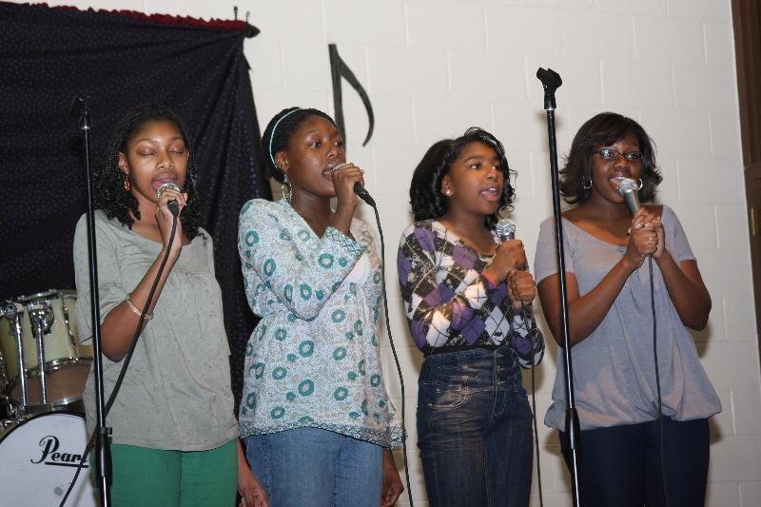
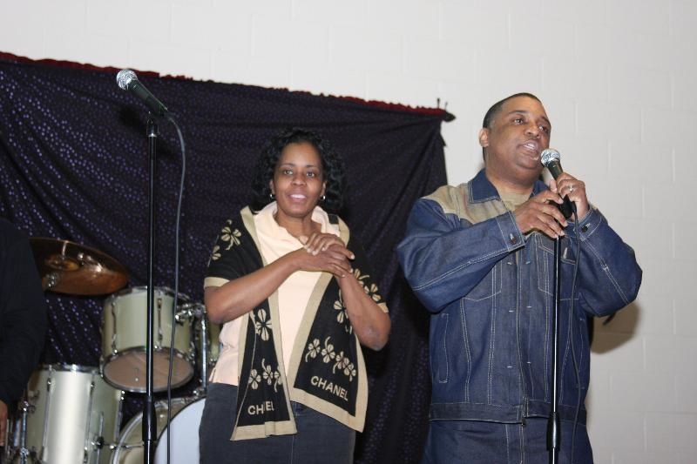
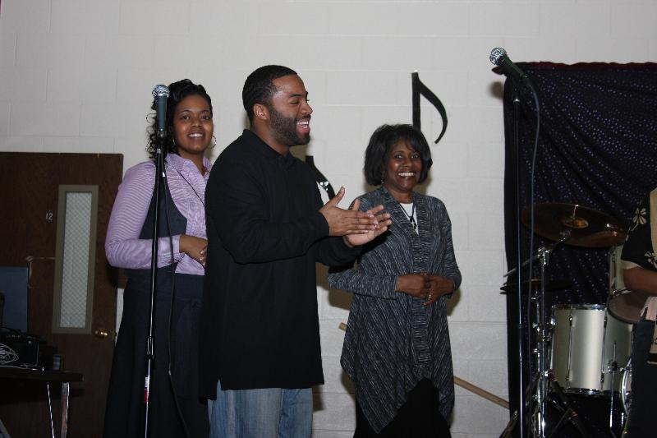
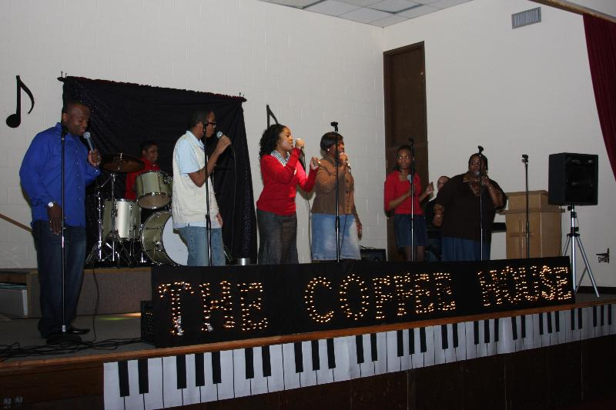
The youth choir produced it’s 2nd annual coffeehouse fundraiser

Slide 3
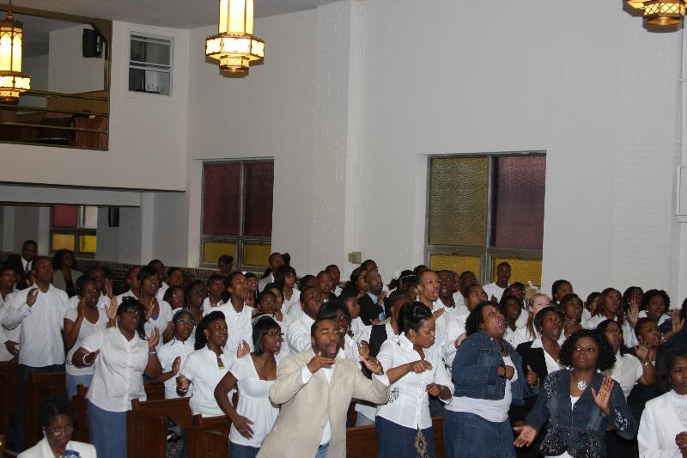
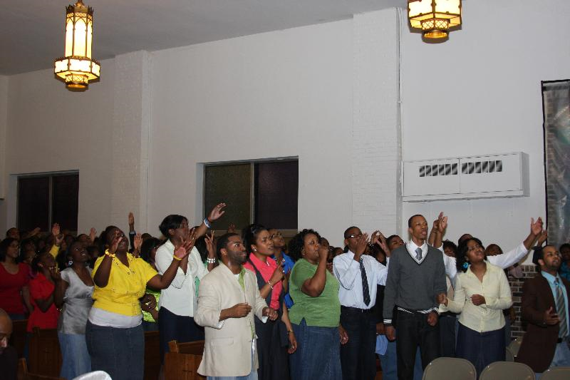
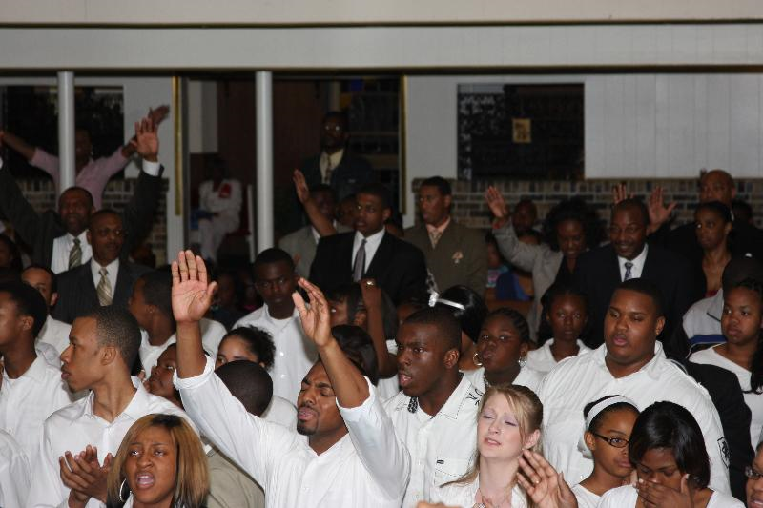
FJI Youth Choir successfully ministered during the AIM Meeting

Slide 4
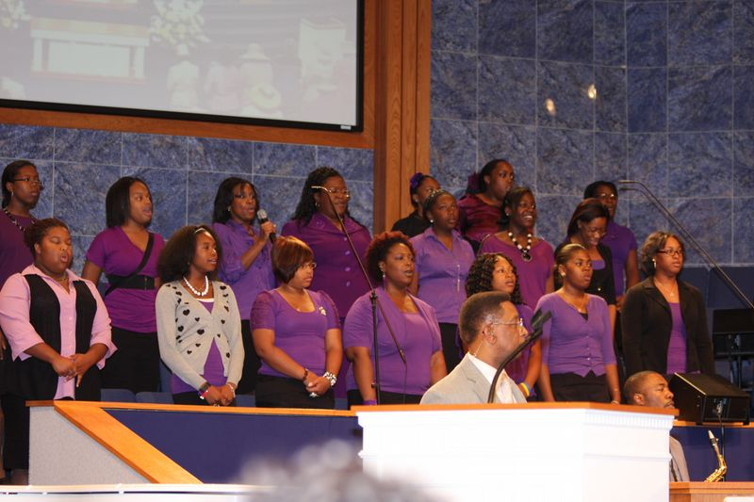
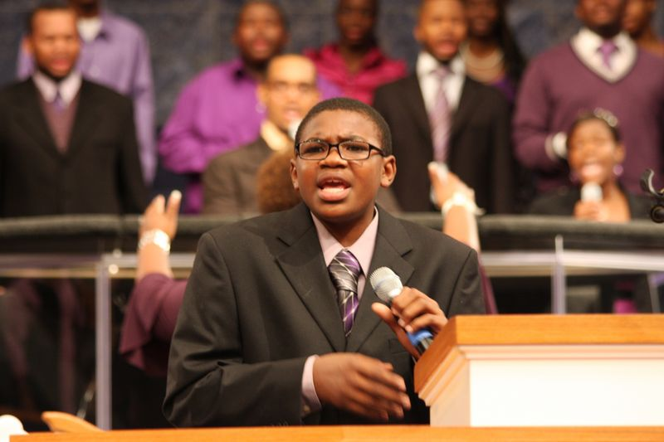
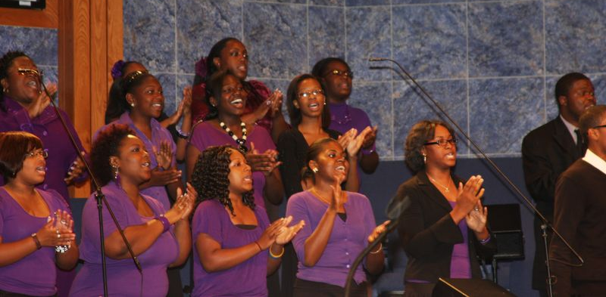

FJI Youth Lead Worship in the Holy Convocation

Slide 5
2012 Youth Choir Events
Coffeehouse and Youth Explosion (date TBD)
Bowling fellowship (date TBD)
AIM rehearsals
  Thursday May 24, 2012 @ 7:00 p.m.-King of Glory Church of God in Christ
  Thursday May 31, 2012 @ 7:00 p.m.-King of Glory Church of God in Christ
  Thursday June 7, 2012 @ 7:00 p.m.-St. Paul Church of God in Christ
AIM Meeting Monday June 11-June 14, 2012 @ 7:00 p.m.-St. Paul
  Music and Youth Night- Wednesday June 13, 2011

