Slide 1
  STEM Education in Arkansas
The Future is Now!
The Future is STEM!
Keith Harris
Science Instructional Specialist
Arkansas Partnership for STEM Education
University of Arkansas at Little Rock
krharris@ualr.edu
501-569-8149

Slide 2
  STEM Education in Arkansas
The Future is Now!
The Future is STEM!
Arkansas Out Of School Network
STEM Academy
Springdale, AR Little Rock, AR
February 21, 2014 March 7, 2014

Slide 3
Arkansas STEM Initiatives
Wednesday, January 11, 2012
Governor's Workforce Cabinet Announces
STEM Works Schools
Governor's Workforce Cabinet announced
the first participants
in the administration's
STEM Works initiative.

Slide 4
The Future is Now!
The Future is STEM!
STEM is vital to
  our future
  our country,
  our state,
  our children.
  STEM
  is everywhere;
  shapes our everyday experiences;
  Considered
    - how often do we experience STEM in our lives?
    - how children are and will be impacted by STEM.

Slide 5
STEM in my Life to get me here Today
Alarm Clock
Microwave
Refrigerator
Municipal water
Plumbing
Electricity
Transportation
Roadways/Interstate System
Cell Phone/Navigation System/Apps
Chemistry /Engineering (Toothpaste/Soap/Shampoo/Shaving Cream/Razor)

Slide 6
The Future is Now!
The Future is STEM!
In this technological age, STEM has
  the best career options, and
  holds the key to wise decisions.
The status of STEM education
STEM strategies
STEM resources

Slide 7
Arkansas STEM Initiatives
Project Lead The Way
includes several introductory courses in engineering or biomedical sciences that show how basic concepts taught in the classroom are used in the work world.

Slide 8
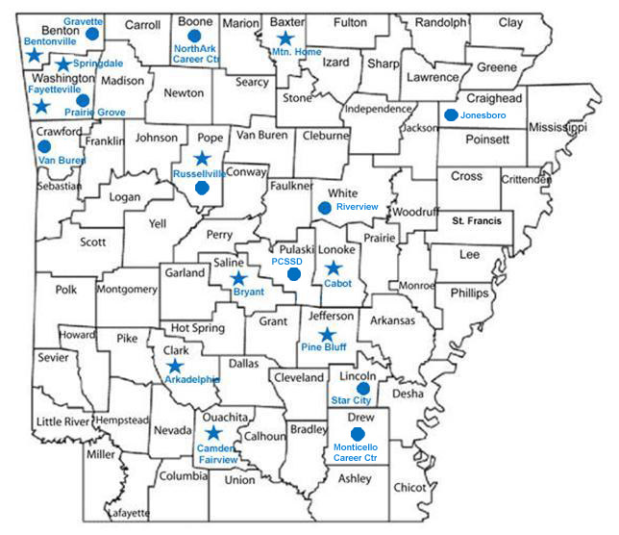
Project Lead the Way
Notes:
A further component of the STEM Works program is the incorporation of Project Lead the Way programs.

Slide 9
Arkansas STEM Initiatives
New Tech High Schools
integrates STEM education and extensive project-based learning throughout the curriculum.

Slide 10
Arkansas STEM Initiatives
UTeach
an innovative teacher preparation program
created to attract STEM majors to secondary teaching careers
prepare STEM majors through advanced field-intensive curriculum
promote professional retention through induction support and ongoing professional development.

Slide 11
UTeach & New Tech High Schools
Gravette SD
Northark Technical Center
Prairie Grove SD
UAF
Jonesboro SD
Lincoln SD
Russellville SD
Cross Co. SD
Riverview SD
UCA
UALR
Star City SD
Notes:
3 Arkansas universities offer the Uteach Program from the University of Texas in Austin starting in fall 2012. Each university completed an application for the Uteach program. In addition, school district applied to become part of the New Tech High School network. You can see that many are clustered around the universities that are interested in the Uteach program. Notice that there are very few student opportunities south of I-30.

Slide 12
  STEM Education Connection
Next Generation Science Standards
Common Core State Standards
Non-Formal Education

Slide 13
Today’s Workforce needs
21st Century Skills
Skills needed to be successful in
K-12 and college education and career

Slide 14
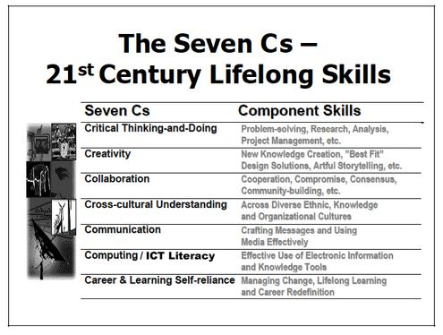

Slide 15
Task
You will be given instructions to perform a common task.
No talking/discussion
After reading the instructions, write down what task you think you are trying to complete, based on the instructions given.

Slide 16
Task Instruction
The procedure is actually quite simple. First you arrange things into different groups. Of course, one group may be sufficient depending on how much there is to do. If you have to go somewhere else due to lack of facilities that is the next step, otherwise you are pretty well set. It is important not to overdo things. That is, it is better to do too few things at once than too many. In the short run this may not seem important but complications can easily arise. A mistake can be expensive as well. At first the whole procedure will seem complicated.

Slide 17
Task Instruction (Continued)
Soon, however, it will become just another facet of life. It is difficult to foresee any end to the necessity for this task in the immediate future, but then one never can tell. After the procedure is completed one arranges the materials into different groups again. Then they can be put into their appropriate places. Eventually they will be used once more and the whole cycle will then have to be repeated. However, that is part of life.

Slide 18
  STEM Careers
    Encouraging STEM Careers
    Salary Info

Slide 19
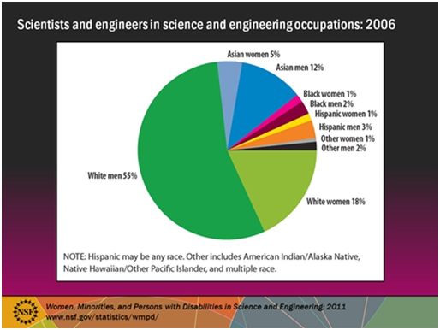
Minorities in STEM

Slide 20
  STEM Careers
    Women in STEM
    Supporting women STEM students and researchers is not only an essential part of America’s strategy to out-innovate, out-educate, and out-build the rest of the world; it is also important to women themselves. Women in STEM jobs earn 33 percent more than those in non-STEM occupations and experience a smaller wage gap relative to men. And STEM careers offer women the opportunity to engage in some of the most exciting realms of discovery and technological innovation. Increasing opportunities for women in these fields is an important step towards realizing greater economic success and equality for women across the board.

Slide 21
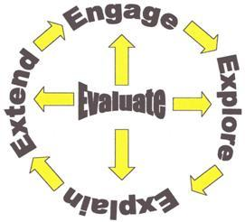
5E Learning Cycle
image from clark-math.blogspot.com

Slide 22
5E Learning Cycle
ENGAGE: capture students' interest with effective questioning
EXPLORATION: activities that encourage focused exploration
EXPLANATION: H.O.T. questions to solicit student explanations to justify exploration; vocabulary is introduced; teacher ASSISTS in explanation
ELABORATION: develop understanding of concept; connect student's observation to terminology
EVALUATION: demonstration of achievement - ongoing throughout lesson as well as at then end.

Slide 23
  STEM Resources
Arkansas STEM Coalition
    Arkansas STEM Center Network

Slide 24
2011 STEM Coalition
Facilitating Grants
Arkansas Commitment to STEM Education Grants for Grades 3-6
  . $3,000 for equipment
  . Professional Development
  . At least 32 School Districts
Notes:
The concept of the Arkansas STEM Coalition has been growing sine 1990 when P-20 education realized that we need to form partnerships and communicate about the rich science and mathematics resources that we had in the state. In 2005, several business partners helped the STEM Coalition organize an infrastructure that began to produce results. Officers were elected and the group began to meet quarterly. The STEM Coalition was granted a non-profit status by the IRS. The Arkansas STEM Center directors now meet regularly after each quarterly meeting. The STEM Coalition sponsored its first state wide meeting in 2008, “Rising Above the Gathering Storm.” In April 2010, the Coalition sponsored the first STEM Policy Summit and has a second one planned for April, 2011. Some of its activities include an administrative role with UTeach, a conduit for grants to promote STEM education, developing an advocacy role to support improvement in STEM education, and producing written reports. Currently the STEM Coalition is developing a 5-year strategic plan and a STEM Website.

Slide 25
Elementary Science Grants
Notes:
The Arkansas Committed to Education gave $205,000 to the STEM Coalition in 2011 to work with the University STEM Centers through a grant process to provide $4,000 worth of science equipment to 32 school districts for elementary school science. The schools are now receiving their science equipment and the teachers are receiving science professional development.

Slide 26
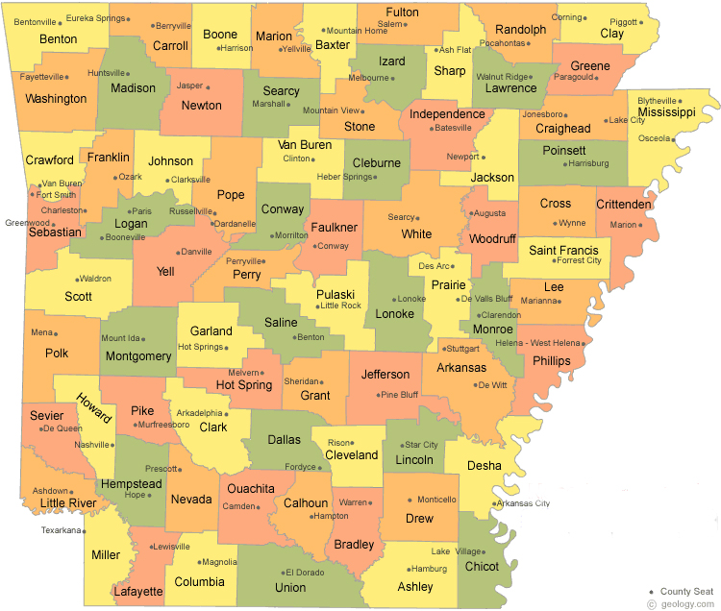
Arkansas Network of Centers for STEM Education
Center for Math & Science Education
NASA Educator Resource Center
Ms. Lynne Hehr
University of Arkansas
346 N. West Avenue
Fayetteville, AR 72701
(479) 575-3875
Center for Mathematics & Science
Dr. Tony Finley
Harding University
Box 12254
Searcy, AR 72149
(501) 279-4242
NEA Rural Institute Math/Science
Ms. Julie Grady
Arkansas State University
P.O. Box 3891 State University, AR 72467-2350
(870) 972-3059
Institute for Math and Science Education
Ms. Darlynn Cast
University of Arkansas - Fort Smith
5210 Grand Avenue, Box 3649
Fort Smith, AR 72913
(479)788-7257
NEA Delta Institute Math/Science
Dr. Cynthia Miller
Arkansas State University
P.O. Box 3891
State University, AR 72467-0184
(870) 972-3436
Satellite location at East Arkansas Community College, Forrest City, AR
Arkansas Center for
Math & Science Education
Dr. Uma Garimella
University of Central Arkansas
UCA Box 5103, 201 Donaghey Avenue
Conway, AR 72035-5005
(501) 450-5663
South Arkansas
Math & Science Center
Ms. Betty Ramsey
Henderson State University
Box 7663
Arkadelphia, AR 71999-0001
(870) 230-5417
Center for Math/Science Education
Dr. Shelton Fitzpatrick
University of Arkansas at Pine Bluff
1200 North University, Mail Slot 4978
Pine Bluff, AR 71601
(870) 575-8051
Center for Teaching Excellence in
Math & Science Education
Dr. Scott White
Southern Arkansas University
P.O. Box 9397
Magnolia, AR 71754
(870)235-4290
Math & Science Partnership
Dr. Angela Sewall
University of Arkansas at Little Rock
2801 South University Drive
Little Rock, AR 72204
501-569-8938
Center for Math & Science Education
Ms. Pam Beard
University of Arkansas at Monticello
397 University Drive, P.O. Box 3480
Monticello, AR 71656
(870) 460-1062
Notes:
Here is a map of the 11 university STEM Centers which have grown in STEM resources over the past 15 years. The Center Directors and the Math and Science Specialists provide professional development to teachers, work with inservice teachers, organize summer student STEM camps, receive grants to promote STEM activities.

Slide 27
  STEM Resources
Arkansas STEM Coalition
    Arkansas STEM Center Network
    Arkansas Science and Technology Authority
    Arkansas Asset Initiative

Slide 28
  STEM Resources
Access Arkansas
VICTER Power Box
BioTech in a Box

