Slide 1

H.O.P.E.
Health Outreach & Prevention Education
Auxiliary to the National Baptist Convention, USA, Inc.
Dr. Julius Scruggs, President
Dr. Calvin McKinney, Secretary
National Baptist Congress of Christian of Education
Dr. George W. Waddles, Sr., Congress President
Dr. Elliott Cuff, Dean
Dr. Doretha Johnson, General Secretary
Dr. Michael O. Minor, NBCUSA National Director &
National H.O.P.E. Coordinator

Slide 2
What Is H.O.P.E.?
The National Baptist Congress Health Outreach and Prevention Education (H.O.P.E.) Initiative is a collaborative effort of National Baptist churches, medical professionals, and health related organizations committed to health outreach and prevention education (H.O.P.E.).

Slide 3
H.O.P.E. Vision
We see a day when all National Baptist churches will have vibrant health and wellness ministries resulting in members being good stewards of their health and wellness.

Slide 4
H.O.P.E. Challenge
We want to make the NBCUSA the healthiest major denomination in America over the next ten years.

Slide 5
H.O.P.E. Mission
We will achieve this vision by reaching out across the depth and breadth of our denomination to educate and inspire our fellow National Baptists to commit to healthier lifestyles through:
  a. health and wellness education;
  b. referral sources and collateral material; and
  c. facilitators and resource persons.

Slide 6
H.O.P.E. Organizational Chart
National Baptist Convention, USA, Inc.
Dr. Julius Scruggs, President
General Secretary
Dr. Doretha Johnson
Research
Dr. Brandi Franklin
Partnerships
Ms. Loretta Miller
Institute
Pastor Bernard Montgomery
National H.O.P.E. Coordinator
Dr. Michael O. Minor
National Baptist Congress of Christian Education
Dr. George W. Waddles, Sr.

Slide 7
H.O.P.E. Research
Working group of academicians and health and wellness researchers
  Identify potential research areas
  Develop and analyze the results of the National Baptist Congress Health and Wellness Survey
  Identify governmental, foundation, and corporate funding and other resources
  Prepare an annual report of activities
Notes:
Help us identify college professors or health researchers in your church or community willing to work with our H.O.P.E. Health Initiative.

Slide 8
H.O.P.E. Partnerships
Other Relevant Organizations
National H.O.P.E. Network Coordinating Council
National Health, Wellness & Disease Entities
H.O.P.E. Partnerships
Loretta Miller
Regional H.O.P.E. Coordinators
State Congresses H.O.P.E. Coordinators
District Congresses H.O.P.E. Coordinators
Local Church Health Ministry Ambassadors
Notes:
The National Health, Wellness, and Disease Entities area includes organizations like Boston Scientific and the American Diabetes Association. The National H.O.P.E. Network Coordinating Council is the centerpiece of our National H.O.P.E. Partnership in which we connect our efforts from the local level to the national level and vice versa. Other Relevant Organizations include groups like fraternities and sororities who have an interest in health and wellness. NBCUSA Certified Church Health Ambassadors®. Each church will select a person to become a certified Church Health Ambassador. These ambassadors shall coordinate church health and wellness ministries in keeping with the program of work of the National H.O.P.E. Initiative.

Slide 9
H.O.P.E. National Partners
Partnership Agreements Completed
American Diabetes Association
American Heart Association/American Stroke Association
American Kidney Fund
Appliance Therapy Group
Easter Seals
National Alliance for Nutrition and Activity (NANA)
Pancreatic Cancer Awareness Network
Sickle Cell Anemia Disease Association
U.S. Department of Health and Human Services Office
of Minority Health
Partnership Agreements Being Developed
American Cancer Society
Health Ministries Association
Methodist Le Bonheur Healthcare

Slide 10
H.O.P.E. Institute
Housed within our existing summer NBC Christian Leadership School
Will offer introductory, intermediate, and advanced level health ministry training
Initially, courses will only be offered at national and regional levels
Will develop certification database
Will collaborate with our Convention’s Ushers and Nurses Auxiliary

Slide 11
H.O.P.E. Institute curriculum
8 hour introductory course
  NBCUSA Certified Health Ministry Ambassador® designation
8 hour intermediate training course:
  Health Ministry Advocate designation
  8 hour leadership training course:
  Congregational Health Leader designation (H.O.P.E. Coordinators)
  10 hour advanced training course:
  Community Health Advocate® designation (non-RN’s) or Faith Community Nurses (RN’s only)
  8 hour annual continuing education training courses

Slide 12
H.O.P.E. certified health ministry ambassador®
8 Hour Introductory Course
(4 two hour modules)
  What is health ministry?
  What is the work of a congregational health ministry?
  What is needed to start a health ministry?
  How do you protect yourself and those you serve?
  This curriculum is based upon paradigms advanced by the International Parish Nurse Resource Center. © 2011 International Parish Nurse Resource Center.

Slide 13
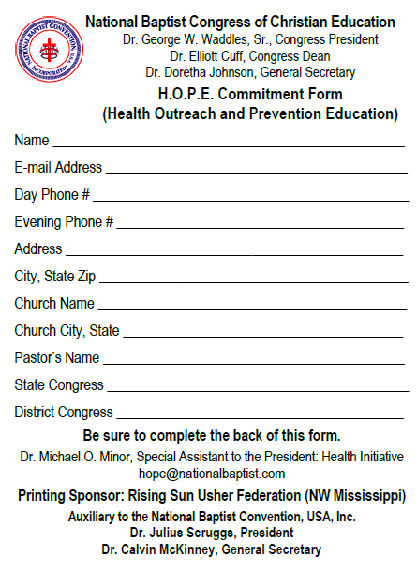
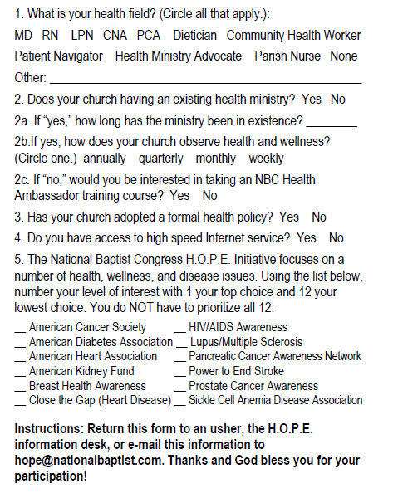
H.O.P.E. Commitment Form

Slide 14
H.O.P.E.: Other initiatives
First Ladies for the First Lady – identifying local church first ladies as advocates for Let’s Move
Certified (Church) Health Campus – certifying church facilities, grounds, and ministries as “pro-” health and wellness
Make the First Five Count® - partnering with Easter Seals’ children’s health initiative

Slide 15

H.O.P.E. 2012
For more information, go to
www.nationalbaptist.com or e-mail hope@nationalbaptist.com
H.O.P.E. Week 2012: St. Louis June 17-22, 2012
H.O.P.E. Conference 2012: Atlanta September 4-6, 2012

