Slide 1
Welcome!
Serving the Hearts and Minds of Central Oregon's First Responders

Slide 2
Our Management
The Central Oregon Public Safety Chaplaincy is a Public Benefit non-profit organization with a volunteer board of members from the community, law enforcement agencies, emergency services agencies, clergy, and professionals that meet monthly to assist the chaplains in accomplishing ministry for our law enforcement and emergency services families in Central Oregon.
We have by-laws to guide and direct us to provide orderly and consistent ministry. They provide an opportunity for direction and accountability for this ministry and the community served. Presently we have two staff chaplains and several volunteer chaplains.

Slide 3
Our History
The Central Oregon Police Chaplaincy (COPC) was established in 1997.
COPC became a 501(c)(3) organization on April 16, 1999.
March 9th, 2017 the COPC Board of Directors changed the name of Central Oregon Police Chaplaincy to Central Oregon Public Safety Chaplaincy. This name change better reflects the mission of COPC: "Serving the Hearts and Minds of Central Oregon’s First Responders".

Slide 4
The COPC Board of Directors
Dave Pickhardt, CHAIRMAN
Crook County Fire & Rescue
Jim Adkins
Jefferson County Sheriff's Office
Hadley Hawkins
U.S. Forest Service
Deron McMaster
Deschutes County Sheriff’s Office
Kevin Dieker
Bend Fire & Rescue
Brent Landels
Bend Realtor
Terry Webb
Calvary Chapel Bend
COPC Staff
Michael Dismore – Staff Chaplain
Joel Stutzman – Staff Chaplain

Slide 5
C
H
A
P
L
A
I
N
S
Kinne Callaway – Bend
Michael Dismore – Redmond
Mike Ferry – Redmond
Lyman Flenner – La Pine
Stephen Gilday – Prineville
Kimi Glaspie – Madras
David Green – Bend
Skip Hinton – Prineville
Terry Jemes – Bend
Leslie Lanquist – Madras
Paul Lanquist – Madras
Don Manning – La Pine
Robin Mirrasoul – La Pine
Peter Pagel – La Pine
Dan Parks – Prineville
Richard Ross – Bend
Joel Stutzman – Sisters
Amber Turnage – Powell Butte
Mark Ward – Bend
Bob Wiley – Redmond

Slide 6
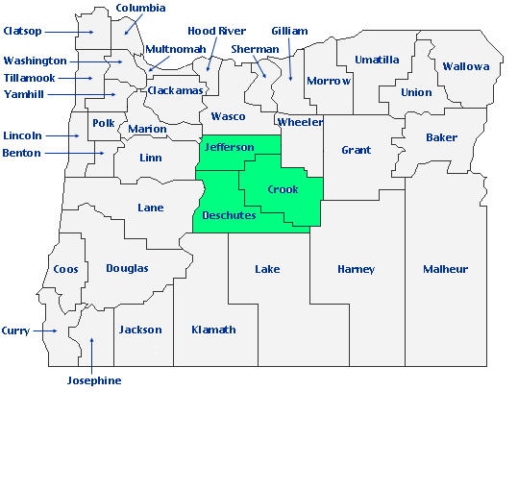
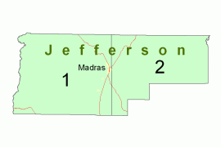
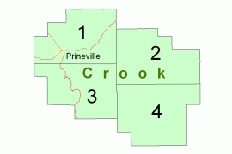
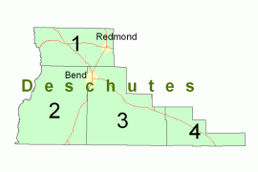
Where We Serve
Deschutes County: Population: 197,692 Square Miles: 3,055
Crook County: Population: 24,404 Square Miles: 2,987
Jefferson County: Population: 24,658 Square Miles: 1,791
* U.S. Census Bureau July 1, 2019

Slide 7
Law Enforcement We Serve
Bend Police Department
Black Butte Police Department
Crook County Search & Rescue
Crook County Sheriff Office
Deschutes County 911 Dispatch
Deschutes County Adult Parole & Probation
Deschutes County Search & Rescue
Deschutes County Sheriff Office
Jefferson County Search & Rescue
Jefferson County Sheriff Office & 911 Dispatch
Madras Police Department
Oregon State Police (Central Oregon)
Prineville Police Department & 911 Dispatch
Redmond Police Department
Sunriver Police Department
Warm Springs Police Department & 911 Dispatch

Slide 8
Fire & Rescue We Serve
Alfalfa Fire District
Bend Fire & Rescue
Black Butte Ranch Rural Fire Protection District
Cloverdale Rural Fire Protection District
Crook County Fire & Rescue
Crooked River Ranch Fire & Rescue
Jefferson County Fire District #1
La Pine Rural Fire Protection District
Lake Chinook Fire & Rescue
Redmond Fire & Rescue
Sisters-Camp Sherman Rural Fire District
Sunriver Fire Department
Warm Springs Fire & Rescue

Slide 9
What We Do
Help Bring Calm To Chaos
Offering a safe place and safe relationship to the First Responders of Central Oregon
Offering help and assistance to those in crisis and facing traumatic circumstances

Slide 10
Confidential Personal Counseling
To police officers and emergency services personnel, their families and the community.

Slide 11
Ride-Alongs
With officers and emergency services personnel, encouraging and establishing trust, identifying with their daily pressures and responsibilities.

Slide 12
Emergency Services
Chaplains are available for on-scene support for all crisis intervention and assistance when needed, including assisting with death notifications.

Slide 13
Search & Rescue
Chaplains are there to assist the Search & Rescue teams as they are called upon for missions, rescues, searches, evacuations, and recoveries.

Slide 14
Hospital and Home Visits
To assist in healing and support ministry.

Slide 15
Providing Critical Incident Stress Management
We are part of the Central Oregon Critical Incident Stress Management (CO-CISM) Team and are available to assist following a critical incident or traumatic event.

Slide 16
Officer Training and Public Awareness
To help emergency services personnel and their family members maintain healthy relationships; to educate our chaplains and the community through classes and Citizen Academy events.

Slide 17
Officiating Services
Celebrating with First Responders and their families in Wedding Celebrations, Vow Renewals, and Baby Dedications. Providing pre- and post-marriage counseling and officiating at funeral services.

Slide 18
Training
Monthly, Annual & Specialized Training
Monthly: Local Training
Annual:
Oregon Chaplains Academy
International Conference of Police Chaplains
International Critical Incident Stress Foundation
Regional Training As Available

Slide 19
Types of Calls and Activities
Administration
Agency Visits
Baby Dedications
Counseling
Critical Incident Stress Management
Death – Natural Causes
Death Notifications
Drownings
Fires
Fund Raising
Funerals
General Counseling
Grief Counseling
Homicides
Hospital & Home Visits
Infant/Child Death
Marriage Counseling
Medical Other
Motor Vehicle Fatalities
Pre-marriage Counseling
Ride Alongs
Search & Rescue/Recovery
Shootings
Suicides
Trainings
Weddings

Slide 20
Funding for COPC
A portion of our funding comes from individuals, families, churches, businesses, agencies and departments, and payroll deductions.
A portion of our funding comes from COPC fundraisers such as an annual Golf Tournament and Sportsmen’s Show Raffle, and Year End Letter.

Slide 21
How You Can Help
Prayer – Pray daily for our Police Officers, Sheriffs & Deputies, Firefighters & Paramedics, Corrections Officers, State Troopers, Dispatchers, and all other Emergency Services of Central Oregon.
Service – We need those in the community to help us with various tasks, programs, and fund-raisers. Please let us know if you can help.
Involving Others – Let others in the community know of the efforts and ministry of COPC.
Much of our funding comes from individuals like you!

Slide 22
Central Oregon Public Safety Chaplaincy
PO Box 1898
Redmond, OR 97756
www.copchaplain.com
Chaplain Mike Dismore; 541-788-3364
mjdismore@gmail.com
Chaplain Joel Stutzman; 541-213-8303
joel.p.stutzman@gmail.com

Slide 23
Thank You!
&
God Bless You!

