Slide 1
SCC University
What we believe and why we believe it!

Slide 2
Revelation

Slide 3
Revelation
1:¹The revelation of Jesus Christ, which God gave him to show to his servants the things that must soon take place. He made it known by sending his angel to his servant John, ² who bore witness to the word of God and to the testimony of Jesus Christ, even to all that he saw.³ Blessed is the one who reads aloud the words of this prophecy, and blessed are those who hear, and who keep what is written in it, for the time is near.
Numbers are important as symbols AND for emphasizing important points

Slide 4
Revelation
Letters to the 7 churches
Same general form
1) Addressee
2) Identification of Christ
With illusions to 1:12-20
3) Claim of knowledge
4) Evaluation – rebukes or commendations
5) Promise or threat – based on evaluation
6) Promise to “the one who conquers” (remains faithful)
7) Exhortation to listen
2 positive, 2 negative, 3 positive/negative

Slide 5
Revelation
¹² Then I turned to see the voice that was speaking to me, and on turning I saw seven golden lampstands, ¹³ and in the midst of the lampstands one like a son of man, clothed with a long robe and with a golden sash around his chest. ¹⁴ The hairs of his head were white, like white wool, like snow. His eyes were like a flame of fire, ¹⁵ his feet were like burnished bronze, refined in a furnace, and his voice was like the roar of many waters. ¹⁶ In his right hand he held seven stars, from his mouth came a sharp two-edged sword, and his face was like the sun shining in full strength.

Slide 6
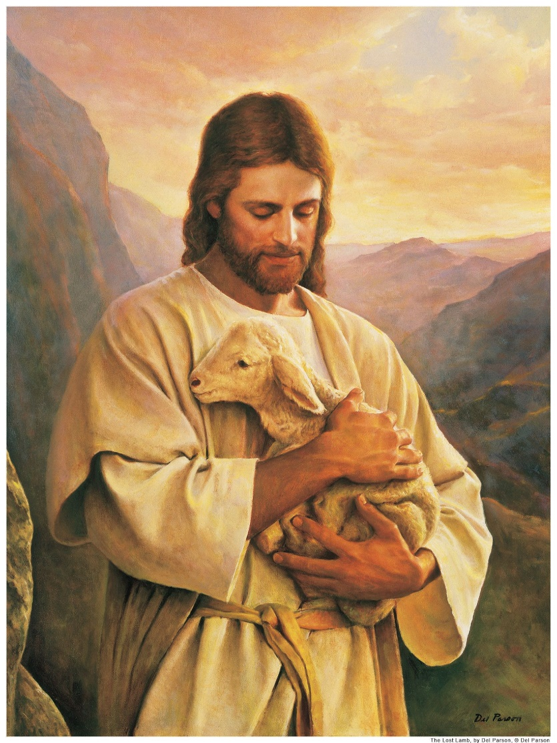
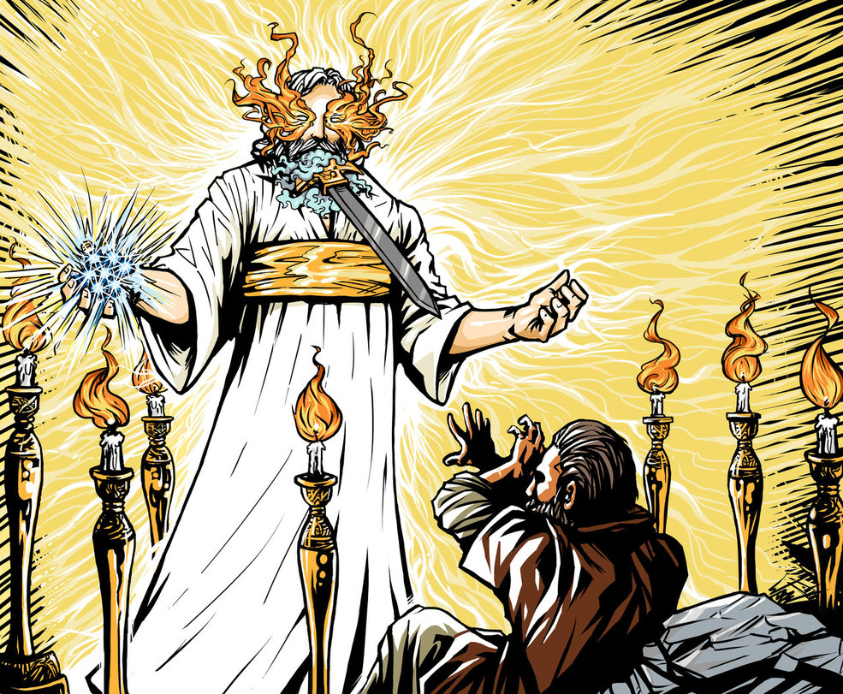
Revelation

Slide 7
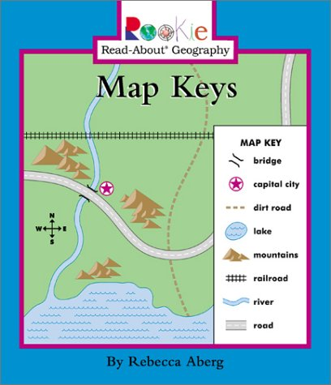
Revelation
⁴ John to the seven churches that are in Asia: Grace to you and peace from him who is and who was and who is to come (see v8), and from the seven spirits who are before his throne, ⁵ and from Jesus Christ the faithful witness, the firstborn of the dead, and the ruler of kings on earth.
Why is the trinity “out of order?”
Why this use of symbolism for the Holy Spirit?
¹² Then I turned to see the voice that was speaking to me, and on turning I saw seven golden lampstands, ¹³ and in the midst of the lampstands one like a son of man,
John intentionally uses this language – seven spirits & lamp stands - as to borrow a dual symbolism presented in Zechariah 4:1-6, & Exodus/Numbers.

Slide 8
Revelation
Zech4:1-6 “What do you see?” I said, “I see, and behold, a lampstand all of gold, with a bowl on the top of it, and seven lamps on it, with seven lips on each of the lamps that are on the top of it. ³ And there are two olive trees by it, one on the right of the bowl and the other on its left.” ⁴ And I said to the angel who talked with me, “What are these, my lord?” ⁵ Then the angel who talked with me answered and said to me, “Do you not know what these are?” I said, “No, my lord.” ⁶ Then he said to me, “This is the word of the Lord to Zerubbabel: Not by might, nor by power, but by my Spirit, says the Lord of hosts…. ⁹ “The hands of Zerubbabel have laid the foundation of this house; his hands shall also complete it.
Ezra 3:8-10 – Zerubbabel is rebuilding the house of God
Ex. 25:31-40 (description) Num. 8:1-4 (location)
Lampstands would have easily been understood as God’s presence shinning out to the world – a light in the darkness

Slide 9
Revelation
Seven Churches:
John intentionally distorts the order of the trinity to bring emphasis to his description of the H.S.
The H.S. is intentionally described in this manner to highlight that this is not a literal letter to seven churches but is a message to THE “church” throughout the age.
See also Rev. 4:5
Why is this important? (Sorry – rhetorical question)
⁴ John to the seven churches that are in Asia: Grace to you and peace …
Rev. 2:8, 2:13, 3:10

Slide 10
Revelation
Seven Churches:
⁴ John to the seven churches that are in Asia: Grace to you and peace from him who is and who was and who is to come, and from the seven spirits who are before his throne, ⁵ and from Jesus Christ the faithful witness, the firstborn of the dead, and the ruler of kings on earth
Gain comfort knowing that the grace and peace John offers is from God through the person of the H.S.
It is important for us all to know that the grace and peace we receive is “complete” – 7 spirits / 7 = number of completeness
18:²⁴In your streets flowed the blood of the prophets and of God’s holy people and the blood of people slaughtered all over the world.”
Notes:
This message of Grace and peace is to all and is especially needed given the message of death and destruction that are presented in this book.

Slide 11
Revelation
⁴ John to the seven churches that are in Asia: Grace to you and peace from him who is and who was and who is to come (see v8), and from the seven spirits who are before his throne, ⁵ and from Jesus Christ the faithful witness, the firstborn of the dead, and the ruler of kings on earth.
One last note on “hope” before we move on.
We can have confidence that the resurrection of the believer is real because Jesus wouldn’t be the “firstborn” if he was going to be the only one reborn from the dead.
The language of hope just OOZES out of every portion of this book. Providence that we see this after Easter?

Slide 12
Revelation
Seven Churches:
2: ¹“To the angel of the church in Ephesus write:… ⁵ Remember therefore from where you have fallen; repent, and do the works you did at first. If not, I will come to you and remove your lampstand from its place, unless you repent.
Because of the symbolism present in Rev. the tendency is to run to the mysterious before the obvious.
“It’s a picture book not a puzzle book.”
Matt. 7: ²¹ “Not everyone who says to me, ‘Lord, Lord,’ will enter the kingdom of heaven…
God’s providence that we just had a sermon on this? (4/7/19)

Slide 13
Revelation – Letters to the churches
1:¹² Then I turned to see the voice that was speaking to me, and on turning I saw seven golden lampstands, ¹³ and in the midst of the lampstands one like a son of man, clothed with a long robe and with a golden sash around his chest. ¹⁴ The hairs of his head were white, like white wool, like snow. His eyes were like a flame of fire, ¹⁵ his feet were like burnished bronze, refined in a furnace, and his voice was like the roar of many waters. ¹⁶ In his right hand he held seven stars, from his mouth came a sharp two-edged sword, and his face was like the sun shining in full strength.
¹⁷ When I saw him, I fell at his feet as though dead. But he laid his right hand on me, saying, “Fear not, I am the first and the last, ¹⁸ and the living one. I died, and behold I am alive forevermore, and I have the keys of Death and Hades. ¹⁹ Write therefore the things that you have seen, those that are and those that are to take place after this.

Slide 14
Revelation – Letters to the churches
2: “To the angel of the church in Ephesus write: ‘The words of him who holds the seven stars in his right hand, who walks among the seven golden lampstands. ² “‘I know your works, your toil and your patient endurance, and how you cannot bear with those who are evil, but have tested those who call themselves apostles and are not, and found them to be false. ³ I know you are enduring patiently and bearing up for my name's sake, and you have not grown weary. ⁴ But I have this against you, that you have abandoned the love you had at first. ⁵ Remember therefore from where you have fallen; repent, and do the works you did at first. If not, I will come to you and remove your lampstand from its place, unless you repent. ⁶ Yet this you have: you hate the works of the Nicolaitans, which I also hate. ⁷ He who has an ear, let him hear what the Spirit says to the churches. To the one who conquers I will grant to eat of the tree of life, which is in the paradise of God.’
Notes:
Ephesus had been relocated because of silt build up that moved the river Cayster and eroded the city

Slide 15
Revelation – Letters to the churches
2: ⁸ “And to the angel of the church in Smyrna write: ‘The words of the first and the last, who died and came to life. ⁹ “‘I know your tribulation and your poverty (but you are rich) and the slander of those who say that they are Jews and are not, but are a synagogue of Satan. ¹⁰ Do not fear what you are about to suffer. Behold, the devil is about to throw some of you into prison, that you may be tested, and for ten days you will have tribulation. Be faithful unto death, and I will give you the crown of life. ¹¹ He who has an ear, let him hear what the Spirit says to the churches. The one who conquers will not be hurt by the second death.’
Notes:
Smyrna – a STRONG HOLD for emperor worship

Slide 16
Revelation – Letters to the churches
2: ¹² “And to the angel of the church in Pergamum write: ‘The words of him who has the sharp two-edged sword.
¹³ “‘I know where you dwell, where Satan's throne is. Yet you hold fast my name, and you did not deny my faith even in the days of Antipas my faithful witness, who was killed among you, where Satan dwells.¹⁴ But I have a few things against you: you have some there who hold the teaching of Balaam, who taught Balak to put a stumbling block before the sons of Israel, so that they might eat food sacrificed to idols and practice sexual immorality. ¹⁵ So also you have some who hold the teaching of the Nicolaitans. ¹⁶ Therefore repent. If not, I will come to you soon and war against them with the sword of my mouth. ¹⁷ He who has an ear, let him hear what the Spirit says to the churches. To the one who conquers I will give some of the hidden manna, and I will give him a white stone, with a new name written on the stone that no one knows except the one who receives it.’
Notes:
Oldest temple in Asia Minor devoted to emperor worship

Slide 17
Revelation – Letters to the churches
2: ¹⁸ “And to the angel of the church in Thyatira write: ‘The words of the Son of God, who has eyes like a flame of fire, and whose feet are like burnished bronze.
¹⁹ “‘I know your works, your love and faith and service and patient endurance, and that your latter works exceed the first. ²⁰ But I have this against you, that you tolerate that woman Jezebel, who calls herself a prophetess and is teaching and seducing my servants to practice sexual immorality and to eat food sacrificed to idols. ²¹ I gave her time to repent, but she refuses to repent of her sexual immorality. ²² Behold, I will throw her onto a sickbed, and those who commit adultery with her I will throw into great tribulation, unless they repent of her works, ²³ and I will strike her children dead. And all the churches will know that I am he who searches mind and heart, and I will give to each of you according to your works. ²⁴ But to the rest of you in Thyatira, who do not hold this teaching, who have not learned what some call the deep things of Satan, to you I say, I do not lay on you any other burden. ²⁵ Only hold fast what you have until I come. ²⁶ The one who conquers and who keeps my works until the end, to him I will give authority over the nations, ²⁷ and he will rule them with a rod of iron, as when earthen pots are broken in pieces, even as I myself have received authority from my Father.²⁸ And I will give him the morning star. ²⁹ He who has an ear, let him hear what the Spirit says to the churches.’
Notes:
Famous guild of Bronze workers – Guilds strongly linked to temple worship.

Slide 18
Revelation – Letters to the churches
3 “And to the angel of the church in Sardis write: ‘The words of him who has the seven spirits of God and the seven stars.
“‘I know your works. You have the reputation of being alive, but you are dead. ² Wake up, and strengthen what remains and is about to die, for I have not found your works complete in the sight of my God.³ Remember, then, what you received and heard. Keep it, and repent. If you will not wake up, I will come like a thief, and you will not know at what hour I will come against you. ⁴ Yet you have still a few names in Sardis, people who have not soiled their garments, and they will walk with me in white, for they are worthy. ⁵ The one who conquers will be clothed thus in white garments, and I will never blot his name out of the book of life. I will confess his name before my Father and before his angels. ⁶ He who has an ear, let him hear what the Spirit says to the churches.’
Notes:
Sardis was a seemingly impregnable fortress that had only fallen a handful of times – Also famed for the place were modern currency was created (ca 560 B.C.)

Slide 19
Revelation – Letters to the churches
3 ⁷ “And to the angel of the church in Philadelphia write: ‘The words of the holy one, the true one, who has the key of David, who opens and no one will shut, who shuts and no one opens.
⁸ “‘I know your works. Behold, I have set before you an open door, which no one is able to shut. I know that you have but little power, and yet you have kept my word and have not denied my name. ⁹ Behold, I will make those of the synagogue of Satan who say that they are Jews and are not, but lie—behold, I will make them come and bow down before your feet, and they will learn that I have loved you. ¹⁰ Because you have kept my word about patient endurance, I will keep you from the hour of trial that is coming on the whole world, to try those who dwell on the earth.¹¹ I am coming soon. Hold fast what you have, so that no one may seize your crown. ¹² The one who conquers, I will make him a pillar in the temple of my God. Never shall he go out of it, and I will write on him the name of my God, and the name of the city of my God, the new Jerusalem, which comes down from my God out of heaven, and my own new name. ¹³ He who has an ear, let him hear what the Spirit says to the churches.’

Slide 20
Revelation – Letters to the churches
3: ⁷ “And to the angel of the church in Philadelphia write: ‘The words of the holy one, the true one, who has the key of David, who opens and no one will shut, who shuts and no one opens.
⁸ “‘I know your works. Behold, I have set before you an open door, which no one is able to shut. I know that you have but little power, and yet you have kept my word and have not denied my name. ⁹ Behold, I will make those of the synagogue of Satan who say that they are Jews and are not, but lie—behold, I will make them come and bow down before your feet, and they will learn that I have loved you. ¹⁰ Because you have kept my word about patient endurance, I will keep you from the hour of trial that is coming on the whole world, to try those who dwell on the earth.¹¹ I am coming soon. Hold fast what you have, so that no one may seize your crown. ¹² The one who conquers, I will make him a pillar in the temple of my God. Never shall he go out of it, and I will write on him the name of my God, and the name of the city of my God, the new Jerusalem, which comes down from my God out of heaven, and my own new name. ¹³ He who has an ear, let him hear what the Spirit says to the churches.’
Notes:
Suffered badly during an earthquake in 16 AD. - sometimes thought to be why we see the reference to “pillar”

Slide 21
Revelation – Letters to the churches
3: ¹⁴ “And to the angel of the church in Laodicea write: ‘The words of the Amen, the faithful and true witness, the beginning of God's creation.
¹⁵ “‘I know your works: you are neither cold nor hot. Would that you were either cold or hot! ¹⁶ So, because you are lukewarm, and neither hot nor cold, I will spit you out of my mouth. ¹⁷ For you say, I am rich, I have prospered, and I need nothing, not realizing that you are wretched, pitiable, poor, blind, and naked. ¹⁸ I counsel you to buy from me gold refined by fire, so that you may be rich, and white garments so that you may clothe yourself and the shame of your nakedness may not be seen, and salve to anoint your eyes, so that you may see. ¹⁹ Those whom I love, I reprove and discipline, so be zealous and repent. ²⁰ Behold, I stand at the door and knock. If anyone hears my voice and opens the door, I will come in to him and eat with him, and he with me. ²¹ The one who conquers, I will grant him to sit with me on my throne, as I also conquered and sat down with my Father on his throne. ²² He who has an ear, let him hear what the Spirit says to the churches.’”
Notes:
Suffered badly during an earthquake in 16 AD. - sometimes thought to be why we see the reference to “pillar”

