Slide 1
SCC University
What we believe and why we believe it!

Slide 2
Study Tactics – Quick Review
3 Basics Stages
Observation
Interpretation
Application

Slide 3
Meaning
What is meaning and who controls it – the author or the reader?
How do we guard against taking control away from the author when interpreting the Bible?
Proper interpretation begins asking the right question (sets your mindset).
What is the meaning God/author intended in this text?
Meaning: timeless truth applicable to all Christians
Application: subjective response by the reader to the meaning of the text as it applies to specific life situations
2 Peter 3:18 - But grow in the grace and knowledge of our Lord and Savior Jesus Christ.

Slide 4
Theological Truths
Two types of theological truths
1) General, universal, theological truths
Broad truths that undergird the whole of the Bible
Commonly convey truths about God, his character, and his actions
2) Context-specific theological truths
Truths based on the general, universal, theological truths, yet more narrowly focused into a specific setting

Slide 5
Theological Truths
God is Holy
Lev. 11
Holiness involves separation of clean from unclean (1 Peter 1:13-20)
All aspects of life must be lived in terms of separation so that they will always be aware of God’s holiness & presence
Holiness involves avoiding unclean food
Practice: 2 Corinthians 8:1-15

Slide 6
2 Peter
Sections of 2 Peter:
Theme: The truth of the gospels is a foundation that stands against false teachers and prophecy
1) Truth of the Gospel 1:3-21
2) Warning about false teachers & prediction about their final judgement: 2:1-22
3) Second coming of Christ: 3:1-18a
A) Peter’s purpose restated, B) The certainty of judgement, C) ethical implications of Christ’s coming, & D) Christ’s coming & judgement as a basis for standing firm against false teaching.

Slide 7
2 Peter
Sections of 2 Peter:
3) Second coming of Christ: 3:1-18a
A) Peter’s purpose restated v1,2 B) The certainty of judgement v3-11
¹ This is now the second letter that I am writing to you, beloved. I am stirring up your sincere mind by way of reminder,² that you should remember the predictions of the holy prophets and the commandment of the Lord and Savior through your apostles, ³ knowing this first of all, that scoffers will come in the last days with scoffing, following their own sinful desires. ⁴ They will say, “Where is the promise of his coming? For ever since the fathers fell asleep, all things are continuing as they were from the beginning of creation.” ⁵ For they deliberately overlook this fact, that the heavens existed long ago, and the earth was formed out of water and through water by the word of God,

Slide 8
2 Peter
Sections of 2 Peter:
3) Second coming of Christ: 3:1-18a
A) Peter’s purpose restated v1,2
Who is being addressed?
1:¹Simeon Peter, a servant and apostle of Jesus Christ, to those who have obtained a faith of equal standing with ours by the righteousness of our God and Savior Jesus Christ:
3:¹ This is now the second letter that I am writing to you, beloved. In both of them I am stirring up your sincere mind

Slide 9
2 Peter
Sections of 2 Peter:
3) Second coming of Christ: 3:1-18a
A) Peter’s purpose restated v1,2 B) The certainty of judgement v3-11
^{1b}…I am stirring up your sincere mind by way of reminder,² that you should remember the predictions of the holy prophets and the commandment of the Lord and Savior through your apostles, ³ knowing this first of all, that scoffers will come in the last days with scoffing, following their own sinful desires. ⁴ They will say, “Where is the promise of his coming? For ever since the fathers fell asleep, all things are continuing as they were from the beginning of creation.” ⁵ For they deliberately overlook this fact, that the heavens existed long ago, and the earth was formed out of water and through water by the word of God,

Slide 10
2 Peter
Sections of 2 Peter:
3) Second coming of Christ: 3:1-18a
Eschatology – theology of end times
Dispensationalism - belief in a system of historical progression, as revealed in the Bible, consisting of a series of stages in God's self-revelation and plan of salvation.
1)Innocence, 2) Conscience, 3) Human Government, 4) Promise, 5) Law, 6) Grace, 7) Millennial Kingdom.
Covenant Theology - It represents the whole of scripture as covenantal in structure and theme. The Old Testament is the old covenant and the New Testament is the new covenant.

Slide 11
2 Peter
Sections of 2 Peter:
3) Second coming of Christ: 3:1-18a
B) The certainty of judgement v3-11
³ … the last days
Acts 2:¹⁴…“Men of Judea and all who dwell in Jerusalem, let this be known to you, and give ear to my words. ¹⁵ For these people are not drunk, as you suppose, since it is only the third hour of the day. ¹⁶ But this is what was uttered through the prophet Joel: ¹⁷ “‘And in the last days it shall be, God declares, that I will pour out my Spirit on all flesh…”
Hebrews 1:2 but in these last days he has spoken to us by his Son (see also 1 Peter 1:20)

Slide 12
2 Peter
Sections of 2 Peter:
3) Second coming of Christ: 3:1-18a
B) The certainty of judgement v3-11
^{1b}…I am stirring up your sincere mind by way of reminder,² that you should remember the predictions of the holy prophets and the commandment of the Lord and Savior through your apostles, ³ knowing this first of all, that scoffers will come in the last days with scoffing, following their own sinful desires. ⁴ They will say, “Where is the promise of his coming? For ever since the fathers fell asleep, all things are continuing as they were from the beginning of creation.”

Slide 13
2 Peter
Sections of 2 Peter:
3) Second coming of Christ: 3:1-18a
B) The certainty of judgement v3-11
⁵ For they deliberately overlook this fact, that the heavens existed long ago, and the earth was formed out of water and through water by the word of God, ⁶ and that by means of these the world that then existed was deluged with water and perished. ⁷ But by the same word the heavens and earth that now exist are stored up for fire, being kept until the day of judgment and destruction of the ungodly.

Slide 14
2 Peter
Sections of 2 Peter:
3) Second coming of Christ: 3:1-18a
B) The certainty of judgement v3-11
⁸ But do not overlook this one fact, beloved, that with the Lord one day is as a thousand years, and a thousand years as one day. ⁹ The Lord is not slow to fulfill his promise as some count slowness, but is patient toward you, not wishing that any should perish, but that all should reach repentance. ¹⁰ But the day of the Lord will come like a thief, and then the heavens will pass away with a roar, and the heavenly bodies will be burned up and dissolved, and the earth and the works that are done on it will be exposed.

Slide 15
2 Peter
Sections of 2 Peter:
3) Second coming of Christ: 3:1-18a
B) The certainty of judgement v3-11
¹ This is now the second letter that I am writing to you, beloved…. ⁸ But do not overlook this one fact, beloved, that with the Lord one day is as a thousand years, and a thousand years as one day. ⁹ The Lord is not slow to fulfill his promise as some count slowness, but is patient toward you, not wishing that any should perish, but that all should reach repentance. ¹⁰ But the day of the Lord will come like a thief, and then the heavens will pass away with a roar, and the heavenly bodies will be burned up and dissolved, and the earth and the works that are done on it will be exposed.

Slide 16
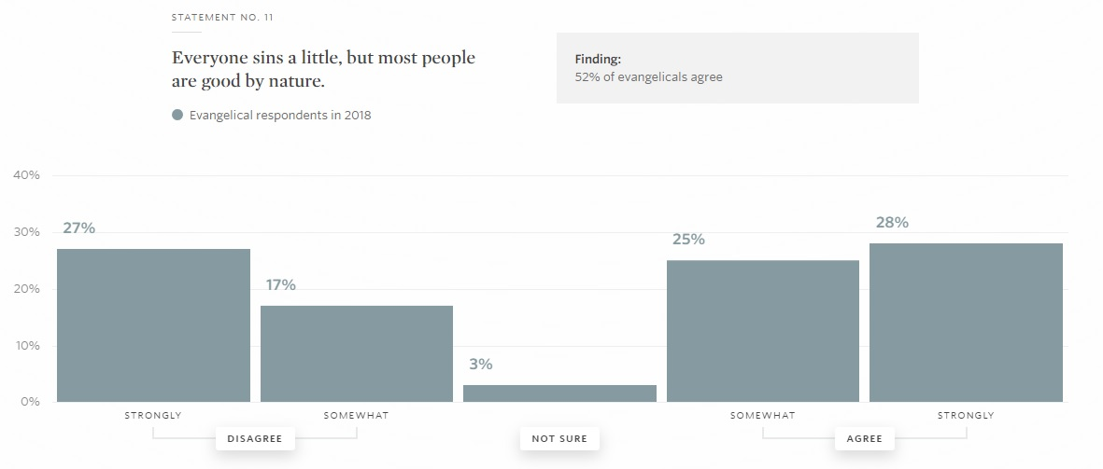
2 Peter
Sections of 2 Peter:
3) Second coming of Christ: 3:1-18a
B) The certainty of judgement v3-11

Slide 17
2 Peter
Sections of 2 Peter:
3) Second coming of Christ: 3:1-18a
B) The certainty of judgement v3-11
Improper understanding of man’s sinful condition gives man a role in his own salvation
Denies God’s sovereignty in election
Devalues Christ’s death on the cross as the payment for the penalty for sin.
Christ’s blood is sufficient for all but only efficient for the elect.

Slide 18
2 Peter
Sections of 2 Peter:
3) Second coming of Christ: 3:1-18a
C) Ethical implications of Christ’s coming v11-16
¹¹ Since all these things are thus to be dissolved, what sort of people ought you to be in lives of holiness and godliness, ¹² waiting for and hastening the coming of the day of God, because of which the heavens will be set on fire and dissolved, and the heavenly bodies will melt as they burn! ¹³ But according to his promise we are waiting for new heavens and a new earth in which righteousness dwells.

Slide 19
2 Peter
Sections of 2 Peter:
3) Second coming of Christ: 3:1-18a
C) Ethical implications of Christ’s coming v11-16
¹⁵ And count the patience of our Lord as salvation, just as our beloved brother Paul also wrote to you according to the wisdom given him, ¹⁶ as he does in all his letters when he speaks in them of these matters. There are some things in them that are hard to understand, which the ignorant and unstable twist to their own destruction, as they do the other Scriptures.

Slide 20
2 Peter
Sections of 2 Peter:
3) Second coming of Christ: 3:1-18a
D) Christ’s coming & judgement as a basis for standing against false teaching v17,18
¹⁷ You therefore, beloved, knowing this beforehand, take care that you are not carried away with the error of lawless people and lose your own stability.¹⁸ But grow in the grace and knowledge of our Lord and Savior Jesus Christ. To him be the glory both now and to the day of eternity. Amen.

