Slide 1
SCC University
What we believe and why we believe it!

Slide 2
Study Tactics – Quick Review
3 Basics Stages
Observation
Interpretation
Application

Slide 3
Study Tactics – Context
Historical-Cultural Context: aka - back-ground
What are we looking for?
1) Ask questions about the author.
2) Ask questions about the audience.
3) Look for historical-cultural elements directly touched on by the scripture.

Slide 4
Study Tactics – Context
Historical-Cultural Context:
Start with the writer
1) what is the writer’s background; 2) where do they come from; 3) when do they write; 4) 4hat kind of ministry do they have; 5) what is their relationship with the audience; 6) why are they writing what they are writing; and 7) how was their relationship with God?
Be mindful of the audience
This can be a bit more challenging but one good first step is become a historical geographer.
Location: political, economic, social (customs), and religious environment the audience is in

Slide 5
Study Tactics – Context
Historical-Cultural Context:
BE CAREFUL!
Watch out for inaccuracy – not all resources are created equal so look for reputable publishers
https://www.ligonier.org/
History is created by “man,” “man” is sinful, so do not elevate background information above the Bible itself.
Watch out for distractions or simply letting the study of history be the end goal.
Pray that additional studies enrich your Bible study

Slide 6
Study Tactics – Context
Literary Context: Surrounding context
1) Immediate Context
The closer the relationship – the greater the influence is.
Chapters and Verses are not part of the original document – they are helpful - but don’t elevate them to heights not intended by the author
2) Greater Literary Context
a) What is the Unit’s role, function, and/or purpose in the book?
b)Why did the author include this section as an important part of the whole?

Slide 7
Study Tactics – Context
Literary Context: Surrounding context
2) Greater Literary Context
Identify Sections
a) Look at how the book is divided into paragraphs.
Compare translations and/or section (if your bible has them)
Try to identify your own section: 1) Conjunctions (therefore, then, but); 2) Changes in style (greetings, prayers, sermons); 3) Changes in topic (theory vs. application)
b) Summarize the main idea of each section
c) Explain how your passage of interest relates to surrounding sections

Slide 8
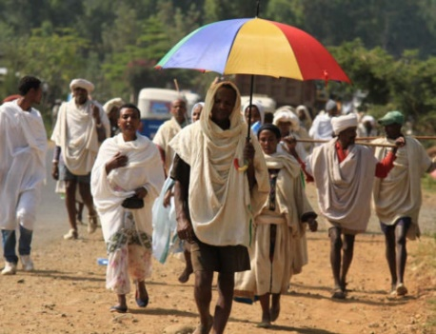
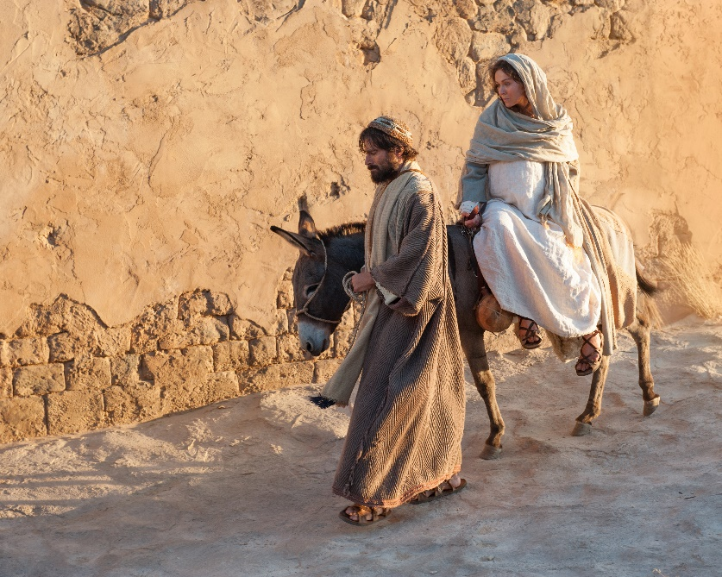
Study Tactics – Pre-Context
Literary Context: Pre-Text
The world from which the reader approaches the text.
These “pre-text” influences have been formed both consciously and subconsciously by a variety of different sources – Luke 2:1-7

Slide 9
Study Tactics – Pre-Context
Literary Context:
1) Preunderstanding
Specific experiences and previous encounters with the text that lead us to assume we already understand it.
Causes us to approach the text with “pride”
Pride does not listen. It knows. – Kevin Vanhoozer
2) World View – Cultural background
Interpretational Reflex – automatic transportation of the biblical text into our cultural context
1) Fills in the gaps and ambiguities
2) Creates a parameter of limiting possibilities for a text before we even attempt to assess meaning: Rom 13:1-7

Slide 10
Study Tactics – Pre-Context
Literary Context: Solution
Total objectivity?
Impossible: Besides we have a living/intimate relationship with God through Christ Jesus, we don’t want to exclude that for the purpose of being “objective”
Approach the text through faith and in the Spirit
Maintain Foundational Truths
1) The Bible is the Word of God, therefore, trustworthy and true; 2) The Bible is not contradictory; it is unified, yet diverse. Nevertheless, God is bigger than we, and as such is not easy to comprehend thus the Bible will also be difficult and or mysterious at times and; 3) Apostle’s Creed or Nicene Creed

Slide 11
Romans
Sections of Romans Ch. 1-11:
Theme: Gospel reveals the righteousness of God
1) Universal nature of man = sinful/unrighteous 1:18-3:20
2) God’s Righteousness for Justification: 3:21-5:21
3) Grace reigns through righteousness: Ch. 6-8
4) God demonstrates his righteousness: Ch. 9-11
Ch. 9 – God’s righteousness est. in history
Ch. 10 – God’s righteousness received only by faith
Ch. 11 – Righteousness revealed in Jew and gentile

Slide 12
Romans
Sections:
2) God’s Righteousness for Justification
3:21-5:21
A. Provided in Christ by faith
B. Proved by the example of Abraham
C. Guarantees blessings for the righteous
D. Rooted in the obedience of Christ – the New Adam
Reiterates point #1!
Magnifies the work of Christ on the cross

Slide 13
Romans
Sections of Romans Ch. 1-11: Section 3: ch. 6-8
3) Grace reigns through righteousness
A. Sin’s dominion broken and its influence resisted: ch.6
6:¹⁴ For sin will have no dominion over you, since you are not under law but under grace.
Indicative statement NOT am imperative
6:³Do you not know that all of us who have been baptized into Christ Jesus were baptized into his death?
6:¹⁷But thanks be to G od…you…have become obedient from the heart…¹⁸having been set free from sin, have become slaves of righteousness (another indicative)
6:²³ For the wages of sin is death, but the free gift of God is eternal life in Christ Jesus our Lord.

Slide 14
Romans
Sections of Romans Ch. 1-11: Section 3: ch. 6-8
3) Grace reigns through righteousness
B. Dead to the Law’s condemnation though not yet made sinless: ch.7
The law no longer holds power for condemnation BUT the law remains for good for those in Christ
7: ¹³ Did that which is good, then, bring death to me? [is the law bad] By no means! [it has a purpose]
¹³ sin might be shown to be sin,
[I] ¹³ might become sinful beyond measure.
¹⁴ [the law good is also good because] …the law is spiritual, but I am of the flesh, sold under sin.

Slide 15
Romans
Sections of Romans Ch. 1-11: Section 3: ch. 6-8
3) Grace reigns through righteousness
B. Dead to the Law’s condemnation though not yet made sinless: ch.7
When I sin, if it’s my fleshes fault, not my “will’s” fault, am I okay to just keep sinning?
6:¹⁵ What then? Are we to sin because we are not under law but under grace? By no means!
7:^{24a} Wretched man that I am!
7:^{24b}Who will deliver me from this body of death?

Slide 16
Romans
Sections of Romans Ch. 1-11: Section 3: ch. 6-8
3) Grace reigns through righteousness
Dead to the Law’s condemnation though not yet made sinless: ch.7
7: ²⁵ Thanks be to God through Jesus Christ our Lord! So then, I myself serve the law of God with my mind, but with my flesh I serve the law of sin.
We have dual being that will not be fully satisfied in the here and now BUT this does not mean we stay the same.

Slide 17
Romans
Sections of Romans Ch. 1-11: Section 3: ch. 6-8
3) Grace reigns through righteousness
C. Those living by the Spirit prove victors over the flesh: ch. 8
8:¹There is therefore now no condemnation for those who are in Christ Jesus. ²For the law of the Spirit of life has set you free in Christ Jesus from the law of sin and death. ³For God has done what the law, weakened by the flesh, could not do. By sending his own Son in the likeness of sinful flesh and for sin, he condemned sin in the flesh, ⁴in order that the righteous requirement of the law might be fulfilled in us, who walk not according to the flesh but according to the Spirit.
How?

Slide 18
Romans
Sections of Romans Ch. 1-11: Section 3: ch. 6-8
3) Grace reigns through righteousness
C. Those living by the Spirit prove victors over the flesh: ch. 8
8:¹³…if by the Spirit you put to death the deeds of the body, you will live. ¹⁴ For all who are led by the Spirit of God are sons of God. ¹⁵ For you did not receive the spirit of slavery to fall back into fear, but you have received the Spirit of adoption as sons, by whom we cry, “Abba! Father!”
8:¹⁷ and if children, then heirs—heirs of God and fellow heirs with Christ, provided we suffer with him in order that we may also be glorified with him.

Slide 19
Romans
Sections of Romans Ch. 1-11: Section 3: ch. 6-8
3) Grace reigns through righteousness
Those living by the Spirit prove victors over the flesh: ch. 8
8:¹⁷ and if children, then heirs—heirs of God and fellow heirs with Christ, provided we suffer with him in order that we may also be glorified with him.
2 Cor. 4:¹⁶ So we do not lose heart. Though our outer self is wasting away, our inner self is being renewed day by day. ¹⁷ For this light momentary affliction is preparing for us an eternal weight of glory beyond all comparison,
8:¹⁸ For I consider that the sufferings of this present time are not worth comparing with the glory that is to be revealed to us.

Slide 20
Romans
Sections of Romans Ch. 1-11: Section 3: ch. 6-8
3) Grace reigns through righteousness
Up to this point
This whole treatise is not an apologetic speech but a love letter of encouragement.
He is saying you are now slaves of a new master (INDICATIVE) so by nature you are going to have a “new” occupation.
BUT that new occupation is at odds with your old self and you know this to be true because you battle with the old (sinful self).
BUT have peace knowing that if you, with/through the Spirit, set your mind on Christ, the Spirit will strengthen you.

Slide 21
Romans
Sections of Romans Ch. 1-11: Section 3: ch. 6-8
3) Grace reigns through righteousness
C. Those living by the Spirit prove victors over the flesh: ch.8
Further encourages us by saying
We are not alone - 8:²² For we know that the whole creation has been groaning together in the pains of childbirth until now.
We have a helper - 8:²⁶ Likewise the Spirit helps us in our weakness. For we do not know what to pray for as we ought, but the Spirit himself intercedes for us

Slide 22
Romans
Sections of Romans Ch. 1-11: Section 3: ch. 6-8
3) Grace reigns through righteousness
C. Those living by the Spirit prove victors over the flesh: ch.8
Provides MORE encouragement by saying…
8:²⁹ For those whom he foreknew he also predestined to be conformed to the image of his Son, in order that he might be the firstborn among many brothers. ³⁰ And those whom he predestined he also called, and those whom he called he also justified, and those whom he justified he also glorified.
Order salutis – Chain of Salvation

Slide 23
Romans
Sections of Romans Ch. 1-11: Section 3: ch. 6-8
3) Grace reigns through righteousness
8:²⁹ For those whom he foreknew he also predestined
John 3:¹⁶ “For God so loved the world, that he gave his only Son, that whoever believes in him should not perish but have eternal life.
2 Pet 3:⁹ The Lord is not slow to fulfill his promise as some count slowness, but is patient toward you, not wishing that any should perish, but that all should reach repentance.

Slide 24
Romans
Sections of Romans Ch. 1-11: Section 3: ch. 6-8
3) Grace reigns through righteousness
C. Those living by the Spirit prove victors over the flesh: ch.8
8:²⁹ For those whom he foreknew he also predestined
Predestination: God decided to save some members of the human race and allow others to perish.
Prescient interpretation: God makes a choice on the basis of his foreknowledge of human decisions or act
He chooses those whom he knows will choose him
Does any one find problems with this interpretation?

Slide 25
Romans
* So which interpretation of predestination is correct? Let’s see what else Paul has to say before we decide.
Sections of Romans Ch. 1-11: Section 3: ch. 6-8
3) Grace reigns through righteousness
C. Those living by the Spirit prove victors over the flesh: ch. 8
8:²⁹ For those whom he foreknew he also predestined*
Reformed interpretation: the ultimate decision for salvation rests with God and not with us – does not rest on foreseen decisions or response by human beings
Man’s “decision” flows from the sovereign grace of God.
Free will exists – it is just that fallen man has no desire for God and will not choose him except by the free/unmerited gift of grace
Does any one find problems with this interpretation?

Slide 26
Romans
Sections of Romans Ch. 1-11: Section 4: ch.9-11
4) God demonstrates his righteousness
A. God’s righteousness est. in history: ch.9
9: ¹I am speaking the truth in Christ—I am not lying; my conscience bears me witness in the Holy Spirit
Context: speaking about the “new” circumstance HIS people, the people of Israel, are now in.
He highlights how God has operated in a “predestinating” manner all along.
Romans 9:6-18
Gen. 17:7,8 Isaac over Ishmael / Gen. 48:13-20 Jacob over Esau

Slide 27
Romans
Sections of Romans Ch. 1-11: Section 4: ch.9-11
4) God demonstrates his righteousness
A. God’s righteousness est. in history: ch.9
9: ¹⁴ What shall we say then? Is there injustice on God's part? By no means! ¹⁵ For he says to Moses, “I will have mercy on whom I have mercy, and I will have compassion on whom I have compassion.” ¹⁶ So then it depends not on human will or exertion, but on God, who has mercy.
That’s not FAIR?
9: ¹⁹ You will say to me then, “Why does he still find fault? For who can resist his will?” ²⁰ But who are you, O man, to answer back to God? Will what is molded say to its molder, “Why have you made me like this?”
It is so not fair that I was born in the U.S. and not Haiti!

Slide 28
Romans
Sections of Romans Ch. 1-11: Section 4: ch.9-11
4) God demonstrates his righteousness
B. Righteousness received only by faith: ch.10
10: ⁸ But what does it say? “The word is near you, in your mouth and in your heart”* (that is, the word of faith that we proclaim); ⁹ because, if you confess with your mouth that Jesus is Lord and believe in your heart that God raised him from the dead, you will be saved. ¹⁰ For with the heart one believes and is justified, and with the mouth one confesses and is saved.
*Duet. 30:11-15

Slide 29
Romans
Sections of Romans Ch. 1-11: Section 4: ch.9-11
4) God demonstrates his righteousness
B. Righteousness received only by faith: ch.10
10: ¹³ For “everyone who calls on the name of the Lord will be saved.” Joel. 2:32 via Acts 2:21
Let’s see what Jesus says
Matt. 10: ⁵ These twelve Jesus sent out, instructing them, “… go rather to the lost sheep of the house of Israel…. ³² So everyone who acknowledges me before men, I also will acknowledge before my Father who is in heaven, ³³ but whoever denies me before men, I also will deny before my Father who is in heaven. ³⁴ “Do not think that I have come to bring peace to the earth. I have not come to bring peace, but a sword. ³⁵ For I have come to set a man against his father, and a daughter against her mother, and a daughter-in-law against her mother-in-law.

Slide 30
Romans
Sections of Romans Ch. 1-11: Section 4: ch.9-11
4) God demonstrates his righteousness
B. Righteousness received only by faith: ch.10
10: ⁸ But what does it say? “The word is near you, in your mouth and in your heart”* (that is, the word of faith that we proclaim); ⁹ because, if you confess with your mouth that Jesus is Lord and believe in your heart that God raised him from the dead, you will be saved. ¹⁰ For with the heart one believes and is justified, and with the mouth one confesses and is saved.
*Duet. 30:11-15

Slide 31
Romans
Sections of Romans Ch. 1-11: Section 4: ch.9-11
4) God demonstrates his righteousness
C. God’s righteousness to all: ch.11
11: I ask, then, has God rejected his people? By no means! For I myself am an Israelite, a descendant of Abraham, a member of the tribe of Benjamin. ² God has not rejected his people whom he foreknew…⁵ So too at the present time there is a remnant, chosen by grace.
Eph. 2:⁸ For by grace you have been saved through faith. And this is not your own doing; it is the gift of God, ⁹ not a result of works, so that no one may boast.

Slide 32
Romans
Remember when I put text boxes around the words “adoption,” “sons,” “heirs”
Sections of Romans Ch. 1-11: Section 4: ch.9-11
Okay – Predestination is Biblical but what is the proper interpretation?
Prescient or Reformed?
Let’s ask Jesus
John 5:25
Romans 3:11-18
Pss: 14:1-3; 5:9, 10: 7, 36:1, 140:3; Prov. 1:16’ Is 59:7,8
John 3:1-15 (5-8)
John 10:1-6

Slide 33
Romans
Sections of Romans Ch. 1-11: Section 4: ch.9-11
I’m still confused?
Your not ALONE!
Romans 11:33-35: "Oh, the depth of the riches and wisdom and knowledge of God! How unsearchable are his judgements and how inscrutable his ways! "For who has known the mind of the Lord, or who has been his counselor?" (Isa. 40:13) "Or who has given a gift to him that he might be repaid?" (Job 35:7, 41:11)."

