Slide 1
SCC University
What we believe and why we believe it!

Slide 2
Study Tactics
3 Basics Stages
Observation
Interpretation
Application

Slide 3
Study Tactics – Context
Historical-Cultural Context: aka - back-ground
God did not dictate the bible in the first person – Craig Keener
God spoke through the human writers of scripture to address the real-life needs of people at a particular time in a particular culture – Scott Duvall & Daniel Hays
Notes:
Ask about love leters

Slide 4
Study Tactics – Context
Historical-Cultural Context: aka - back-ground
The way we approach the Bible (the way we listen to God) should match how God gave us the Bible (they way God Chose to speak). Scott Duvall & Daniel Hays
We should not be so arrogant and prideful as to think that God cared nothing about the original audience but was merely using them to get a message to us. Scott Duvall & Daniel Hays

Slide 5
Study Tactics – Context
Historical-Cultural Context: aka - back-ground
2 Timothy 4
Verse 6:
Verse 9:
Verse 12:
Verse 21:
⁶ For I am already being poured out as a drink offering, and the time of my departure has come.
⁹ Do your best to come to me soon.
¹² Tychicus I have sent to Ephesus.
²¹ Do your best to come before winter.
Notes:
Sea Travel – dangerous Sept. to Nov; Nov. to March = closed, march – April = dangerous

Slide 6
Study Tactics – Context
Historical-Cultural Context: aka - back-ground
What are we looking for?
1) Ask questions about the author.
2) Ask questions about the audience.
3) Look for historical-cultural elements directly touched on by the scripture.

Slide 7
Study Tactics – Context
Historical-Cultural Context:
Start with the writer
1) what is the writer’s background; 2) where do they come from; 3) when do they write; 4) 4hat kind of ministry do they have; 5) what is their relationship with the audience; 6) why are they writing what they are writing; and 7) how was their relationship with God?
Be mindful of the audience
This can be a bit more challenging but one good first step is become a historical geographer.
Location: political, economic, social (customs), and religious environment the audience is in

Slide 8
Study Tactics – Context
Historical-Cultural Context:
BE CAREFUL!
Watch out for inaccuracy – not all resources are created equal so look for reputable publishers
https://www.ligonier.org/
History is created by “man,” “man” is sinful, so do not elevate background information above the Bible itself.
Watch out for distractions or simply letting the study of history be the end goal.
Pray that additional studies enrich your Bible study

Slide 9
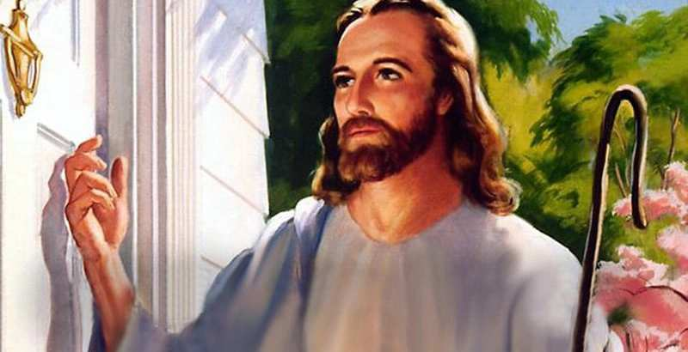
Study Tactics – Context
Historical-Cultural Context: Laodicea
Revelation 3:14-22
“‘I know your works: you are neither cold nor hot. Would that you were either cold or hot! ¹⁶ So, because you are lukewarm, and neither hot nor cold, I will spit you out of my mouth. ¹⁷ For you say, I am rich, I have prospered, and I need nothing, not realizing that you are wretched, pitiable, poor, blind, and naked. ¹⁸ I counsel you to buy from me gold refined by fire, so that you may be rich, and white garments so that you may clothe yourself and the shame of your nakedness may not be seen, and salve to anoint your eyes, so that you may see. ¹⁹ Those whom I love, I reprove and discipline, so be zealous and repent. ²⁰ Behold, I stand at the door and knock. If anyone hears my voice and opens the door, I will come in to him and eat with him, and he with me. ²¹ The one who conquers, I will grant him to sit with me on my throne, as I also conquered and sat down with my Father on his throne. ²² He who has an ear, let him hear what the Spirit says to the churches.’”

Slide 10
Study Tactics – Context
Historical-Cultural Context: Laodicea
https://en.wikipedia.org/wiki/Laodicea_on_the_Lycus
1) High degree of prosperity
Large money transaction
Minted their own coins
Extensive trade in black wool
2) Advances in Science
A great medical school
3) Physical relation to Colassae & Hierapolis
Architecture/drinking water

Slide 11
Study Tactics – Context
Historical-Cultural Context: Laodicea
Revelation 3:14-22
“‘I know your works: you are neither cold nor hot. Would that you were either cold or hot! ¹⁶ So, because you are lukewarm, and neither hot nor cold, I will spit you out of my mouth. ¹⁷ For you say, I am rich, I have prospered, and I need nothing, not realizing that you are wretched, pitiable, poor, blind, and naked. ¹⁸ I counsel you to buy from me gold refined by fire, so that you may be rich, and white garments so that you may clothe yourself and the shame of your nakedness may not be seen, and salve to anoint your eyes, so that you may see. ¹⁹ Those whom I love, I reprove and discipline, so be zealous and repent. ²⁰ Behold, I stand at the door and knock. If anyone hears my voice and opens the door, I will come in to him and eat with him, and he with me. ²¹ The one who conquers, I will grant him to sit with me on my throne, as I also conquered and sat down with my Father on his throne. ²² He who has an ear, let him hear what the Spirit says to the churches.’”

Slide 12
Romans
Organization
Chapters 1-3:21
Greetings
1:1-15
Theme
1:16,17
Universal nature of man = sinful - unrighteous
1:18-3:20
Gentile – 1:18-32, Jew – 2:1-3:8, Universal – 3:9-20
Homework: read Romans 3:21- (ch)11 and identify “themes/sections/units, etc…”
Notes:
Takes about 9 minutes with semi-careful reading

Slide 13
Romans
Theme
1:16,17
¹⁶ For I am not ashamed of the gospel, for it is the power of God for salvation to everyone who believes, to the Jew first and also to the Greek. ¹⁷ For in it the righteousness of God is revealed from faith for faith, as it is written, “The righteous shall live by faith.”
Hab. 2:4
Behold, his soul is puffed up; it is not upright within him, but the righteous shall live by his faith.

Slide 14
Romans
Theme
Righteous – Righteousness
characterized by uprightness or morality: morally right or justifiable: acting in an upright, moral way; virtuous:
¹⁶ For I am not ashamed of the gospel, for it is the power of God for salvation to everyone who believes, to the Jew first and also to the Greek. ¹⁷ For in it the righteousness of God is revealed from faith for faith, as it is written, “The righteous shall live by faith.”

Slide 15
Romans
Theme
Righteous – Righteousness
Dikaiosuné (dik-ah-yos-oo'-nay): righteousness, justice
In a Jewish atmosphere: justice, justness, righteousness, righteousness of which God is the source or author, but practically: a divine righteousness
dikaiosýnē - "a judicial verdict" – properly, judicial approval; in NT refers to what is deemed right by the Lord (after His examination)

Slide 16
Romans
Theme
Righteous – Righteousness
Dikaiosuné (dik-ah-yos-oo'-nay): righteousness, justice
dikaiosýnē - "a judicial verdict" – properly, judicial approval; in NT refers to what is deemed right by the Lord (after His examination)
¹⁶ For I am not ashamed of the gospel, for it is the power of God for salvation to everyone who believes, to the Jew first and also to the Greek. ¹⁷ For in it the righteousness of God is revealed from faith for faith, as it is written, “The righteous shall live by faith.”

Slide 17
Romans
Theme
“from faith for faith”
God’s righteousness [judicial approval] is shown in the righteousness of Christ that is imputed to, or considered by God to belong to, the one who believes. This imputation of righteousness to sinners who believe is fully consistent with the personal righteousness of God. – R.C. Sproul
“From faith for Faith” indicates that God has not “changed” his plans. This system has always been in place(i.e. Hab 2:4) – it is just that we now have it fully displayed

Slide 18
Romans
Sections of Romans ch. 1-11:
Universal nature of man = sinful - unrighteous
1:18-3:20
Gentile 1:18-32,
Jew – 2:1-3:8,
Universal – 3:9-20
God’s Righteousness for Justification
3:21-5:21

Slide 19
Romans
Sections:
God’s Righteousness for Justification
3:21-5:21
3:21-31
4
5:1-11
5:12-21

Slide 20
Romans
Sections:
God’s Righteousness for Justification
3:21-5:21
1) Provided in Christ by faith
2) Proved by the example of Abraham
3) Guarantees blessings for the righteous
4) Rooted in the obedience of Christ – the New Adam
Reiterates point #1!
Homework: Identify sections/sub-sections in chapters 6-11

