Slide 1
SCC University
What we believe and why we believe it!

Slide 2
Acts
Genre = Historical Narrative
Sequel to the gospel of Luke
In the early church these two books often accompanied one another.
Thematic similarities
Importance of Prayer
Work of the Spirit
The gospel is for all.
Goal = The book of Acts is not only the acts of the apostles, but the acts of the risen, living Jesus. John Piper

Slide 3
Acts
History (descriptive) AND Theology (normative)?
1) Read passages in relation to the rest of Acts and the Bible
2) Speeches - Paraphrased accounts advance specific points
3) Identify Positive & Negative Characters

Slide 4
Study Tactics
3 Basics Stages
Observation
Interpretation
Application

Slide 5
Study Tactics – The Sentence
God communicates to us through his word
Problem = we read the Bible to quickly
Think about dinner – a good meal requires effort
What does this mean? What am I supposed to do with it?
Starting small forces us to slow down and be more thoughtful – helps us SEE DETAIL
“Hi Will”

Slide 6
Study Tactics – The Sentence
Observation
Seeing Detail
We are not asking “what does it mean”
We are asking “what does it say”
Not starting off in a vacuum
Larger units of text provide context
Small parts support larger whole

Slide 7
Study Tactics – The Sentence
Observation
1) Repetition of Words
1 John 2:15-17
“world” & “love”
Are they in every sentence?
How many times does it occur in all?
Does it always have the definite article “the”?
Practice - 2 Cor. 1:3-7

Slide 8
Study Tactics – The Sentence
Observation
2) Contrast
Proverbs 14:31
Two types of people
What does the contrasting personas tell us?
Romans 6:23
What does this contrast help explain?
Practice – 1 John 1:5-7
Side note – contrast can take place over several verses

Slide 9
Study Tactics – The Sentence
Observation
3) Comparisons
Proverbs 25:26
What is being compared
What are the implications
Importance of a spring?
Isaiah 40:31
Practice – James 3:3-6

Slide 10
Study Tactics – The Sentence
Observation
4) Lists
More than two itemized things
Galatians 5:19-21
Are the items written in particular order
Are they grouped in any way
Practice – Galatians 5:22-23

Slide 11
Study Tactics – The Sentence
Observation
5) Cause and Effect
Proverbs 15:1
Causes?
Effects?
Cause and effect relationships are very important in communicating vital Christian truths
Ex. Romans 6:23, Romans 12:2, Colossians 3:1
Practice – look up the above scriptures
Bonus – can anyone identify what else Pro. 15:1 is?

Slide 12
Study Tactics – The Sentence
Observation
6) Figures of Speech
Images in which words are used in a sense other than the normal, literal sense.
Psalm 119:105 Your word is a lamp to my feet and a light to my path.
Paint images which we can relate to emotionally.
Practice – Matthew 23:27
Take a moment to visualize – even relate the the image.

Slide 13
Study Tactics – The Sentence
Observation
7) Conjunctions
“Are mortar that hold all the bricks together.”
And, for, but, therefore, since, because, etc…
Therefore – what’s it there for?
Romans 12:1 Therefore, I urge you, brothers and sisters, in view of God’s mercy, to offer your bodies as a living sacrifice, holy and pleasing to God—this is your true and proper worship.
Require knowing the larger picture. Romans 1-11 = Theology of salvation by grace through faith. “Therefore” is thus making us aware that Paul is moving into the “application” portion of his letter
Practice – Col. 3:12 = “therefore”, read 1-11 to gain full insight

Slide 14
Acts of the Apostles: ch 2-8
2 sermons, 2 lectures, and 1 personal evangelism
Sermons
Pentecost
Solomon’s Portico
Lectures
Jewish Council x 2 (Peter and Stephen)
Personal evangelism
Philip and the Ethiopian Eunuch

Slide 15
Acts of the Apostles
Sermons
Pentecost 2:14-41
Peter
²³ this Jesus, delivered up according to the definite plan and foreknowledge of God, you crucified and killed by the hands of lawless men. ²⁴ God raised him up, loosing the pangs of death, because it was not possible for him to be held by it [32]. ²⁵ For David says concerning him…
V38 Repent and be baptized every one of you in the name of Jesus Christ for the forgiveness of your sins

Slide 16
Acts of the Apostles
Sermons
Solomon’s Portico: 3:11-26
Peter
¹⁴ But you denied the Holy and Righteous One, and asked for a murderer to be granted to you, ¹⁵ and you killed the Author of life, whom God raised from the dead. To this we are witnesses.
¹⁹ Repent therefore, and turn back, that your sins may be blotted out,
²² Moses said….

Slide 17
Acts of the Apostles
Lectures
Before the Jewish Council
Peter: Acts 4:8-22
⁸ Then Peter, filled with the Holy Spirit, said to them, “Rulers of the people and elders, ⁹ if we are being examined today concerning a good deed done to a crippled man, by what means this man has been healed, ¹⁰ let it be known to all of you and to all the people of Israel that by the name of Jesus Christ of Nazareth, whom you crucified, whom God raised from the dead—by him this man is standing before you well.
Stephen: Acts 1-60
V52-53 = Christ crucified & v56 Christ raised up

Slide 18
Acts of the Apostles
Personal Evangelism
Philip: Acts 8: 26-40
⁵ Philip went down to the city of Samaria and proclaimed to them the Christ.⁶ And the crowds with one accord paid attention to what was being said by Philip…⁸ So there was much joy in that city.
*side note – Scattering in the O.T. was a form of punishment but here the great faith of Stephen led to a “scattering” expands the good news
Duet 28:64-68, Ezek 36:19-21
Acts 1:⁸ But you will receive power when the Holy Spirit has come upon you, and you will be my witnesses in Jerusalem and in all Judea and Samaria, and to the end of the earth.”
“The blood of Christians is the seed of the church.” Tertullian

Slide 19
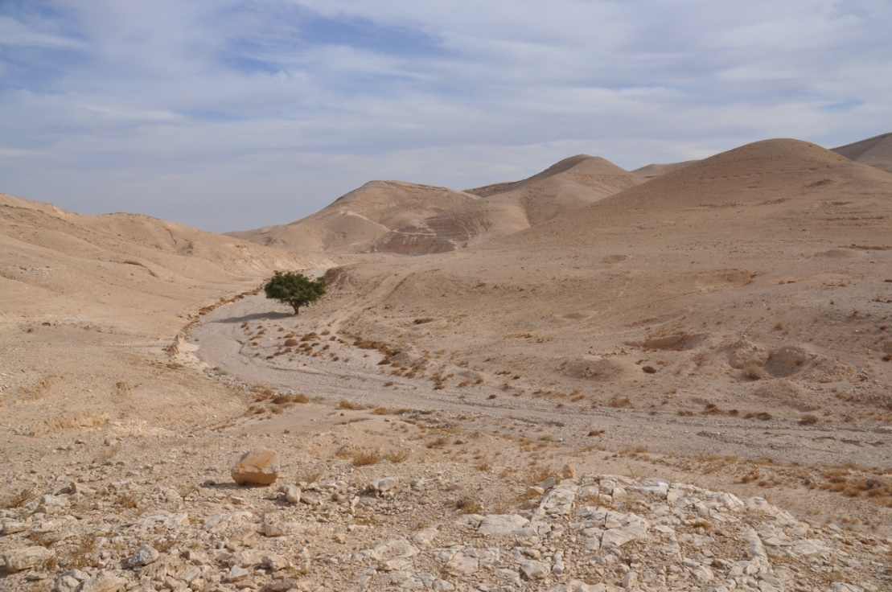
Acts of the Apostles
Personal Evangelism
Philip: Acts 8: 26-40
²⁶ Now an angel of the Lord said to Philip, “Rise and go toward the south to the road that goes down from Jerusalem to Gaza.” This is a desert place.
²⁷ ...an Ethiopian, a eunuch, a court official of Candace, queen of the Ethiopians, who was in charge of all her treasure.
²⁹ And the Spirit said to Philip, “Go over and join this chariot.”
³⁵ Then Philip opened his mouth, and beginning with this Scripture he told him the good news about Jesus. [v36]

Slide 20
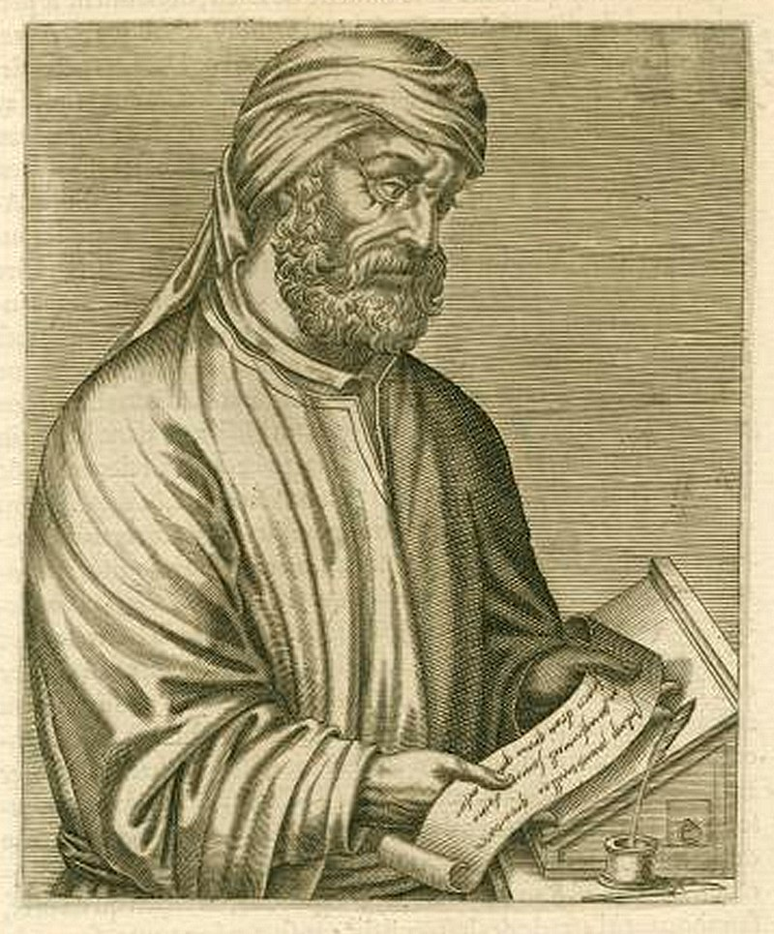
Acts of the Apostles
Sharing the Gospel is sharing Christ Jesus
Actual facts based on historical events
Relating the condition of sinful man
You don’t have to say “hey you killed Christ”
Acts 19:8-10 & 23-37
³⁷ For you have brought these men here who are neither sacrilegious nor blasphemers of our goddess.
Christ’s death and resurrection is REAL
Forgiveness for our sin through Christ upon belief

